Slide 1
MANAGERIAL ECONOMICS
Economics is a study of human activity. Both at human activity in individual and national level. The economists of early age treated economics merely as the “Science of wealth”. Every one of us is involved in efforts aimed of earning money and spending this Money to satisfy our wants such as food, clothing, shelter and others. Such activities of earning and spending money are called Economics activities.
It was only during the 18th Century that “Adam Smith”, the father of economics defined economics as the study of nature and uses of national wealth.
Managerial Economics is the application of the tools of economic Analysis in decision making in Actual business Situations.
MANAGEMENT: Management deals with principles i.e., planning, organizing, leading and controlling, which helps in decision-making under uncertainty and improve the effectiveness of organization.

Slide 2
ECONOMICS: Economics is mainly concern in analysing and providing solution to the various economic problems. It is divided into two types
1. Micro economics
2. Macro economics
Micro Economics:
It deals with the problems of an individual firm, Industry etc. it helps the Organization in such
Way that the available resources are efficiently, it is also called “Theory of Firm”
Macro Economics:
The study of aggregate or total level of economic activity in a country is called macroeconomics.
It studies the flow of economic resources or factors of production ( such as land, labour, capital organisation and technology)

Slide 3
DEFINITIONs of Managerial economics
It is a discipline that deals with the applications of economics concepts, theories, tools and methodologies to the practical problems in a business.
According to “Prof. Spencer Siegelman” : “Managerial economics is the integration of economic theory with business practice for the purpose of facilitating decision-making and forward planning by management”.
According to Adam Smith “Economics as the study of nature and uses of national wealth”.
According to Dr. Alfred Marshall “Economics is a study of man’s actions in the ordinary business of life: it enquires how he gets his income and how he uses it”.
NATURE / CHARACTERSTICS OF MANAGERIAL ECONOMICS:
The features of managerial economics are as follows:
Close to Micro Economics: Managerial economics is concerned with finding the solution for different managerial economics problems of a particular firm.
Operates against the back drop of a Macro economics: The macro economics conditions of the economy are also seen as limiting factors for the firm to operate. The managerial economist has to be aware of the limits set by the macro economics conditions such as Government, industrial policy and inflation.

Slide 4
Normative statement: Managerial economics is normative in nature. It offers recommendations and prescriptions for decision-making. Instead of just describing how things work, it tells you what you need to do to reach your goals. Managers use this approach to handle challenges and make good decisions.
usually includes (or) implies the words ‘ought’ (or) ‘should’. They reflect peoples moral attitudes are expressions of what a term of people should do.
Eg: It deals with statements such as ‘Government of India should open up the economy’ such statements are based on value judgment and express views of what is good (or) bad, right (or) wrong. One problem with normative statement is that they cannot be verified by looking at the facts, because they mostly deal with the future.
Applied in nature: Models are built to reflect the real life complex business situations, these models are of immense help to manage for decision making. In managerial economics we also employ case study method to conceptualize the problem, identify the alternatives and determine the best course of action.
To Evaluate each alternatives: Managerial economics provides an opportunity to evaluate each alternatives in terms of its costs and revenues. The managerial economist can decide which is the better alternative to maximize the profits for the firm.
Interdisciplinary: The contents tools, techniques of managerial economics are drawn from different subjects such as economics, Management, Mathematics, Statistics, Psychology, Organizational Behavior, Sociology etc.
Assumptions & Limitations: Every concepts and theory of Managerial economics is based on certain assumptions and as such their validity is not universal.

Slide 5
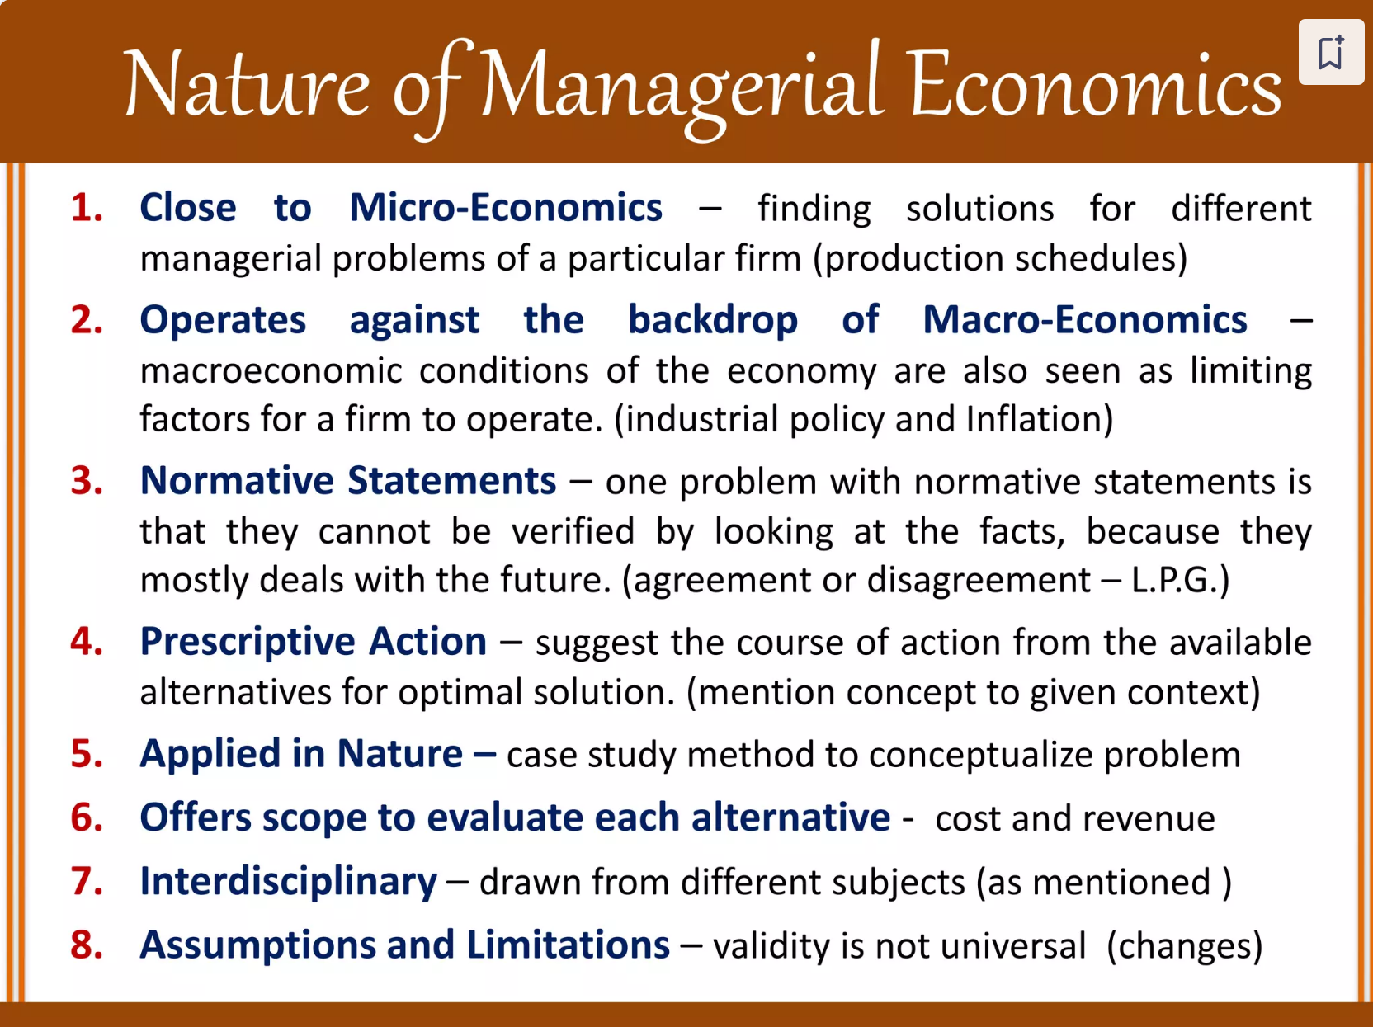

Slide 6
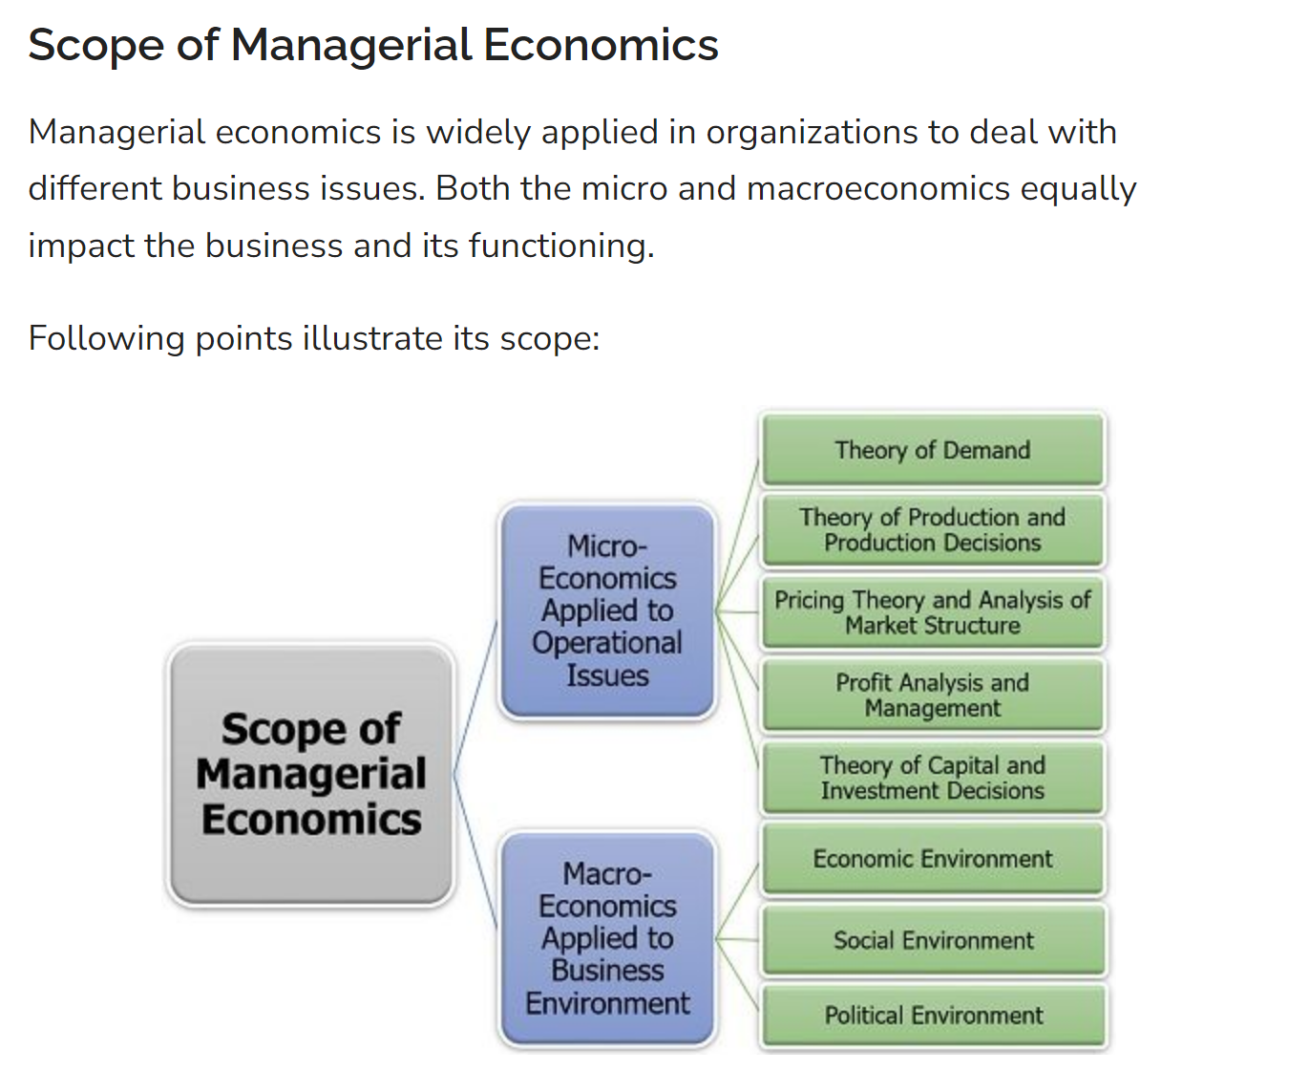

Slide 7
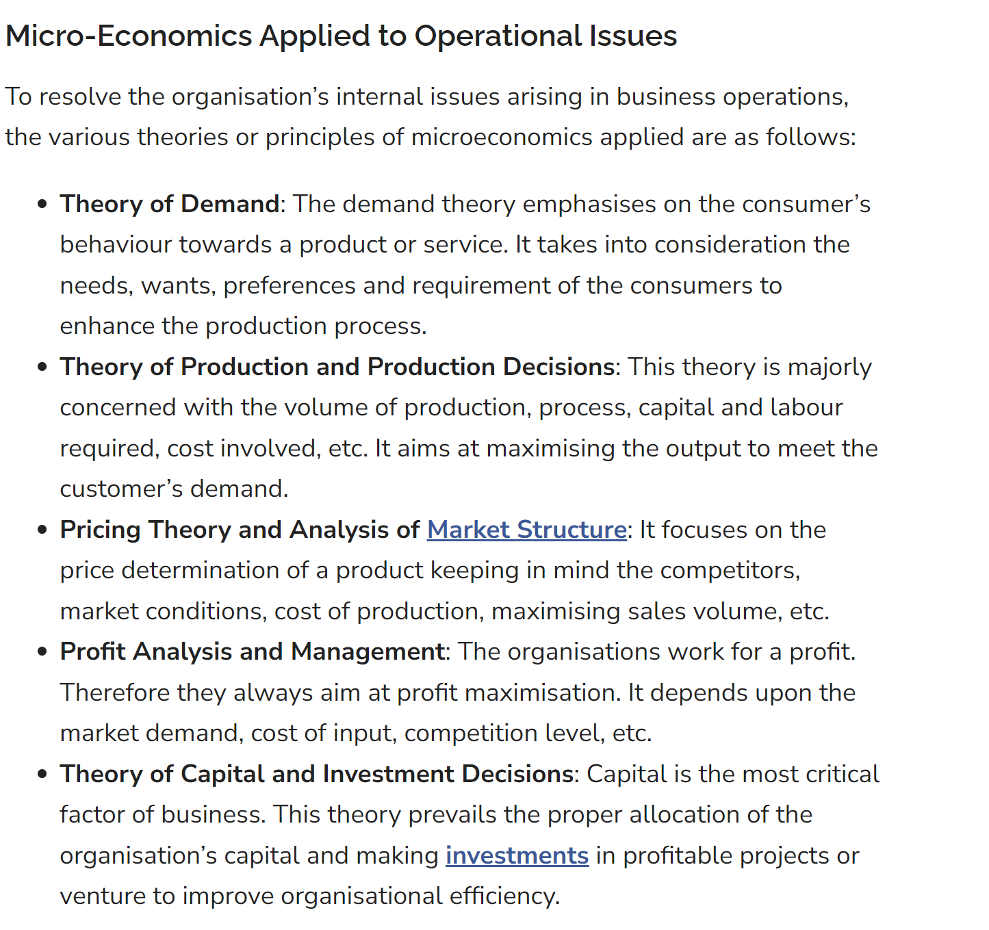

Slide 8
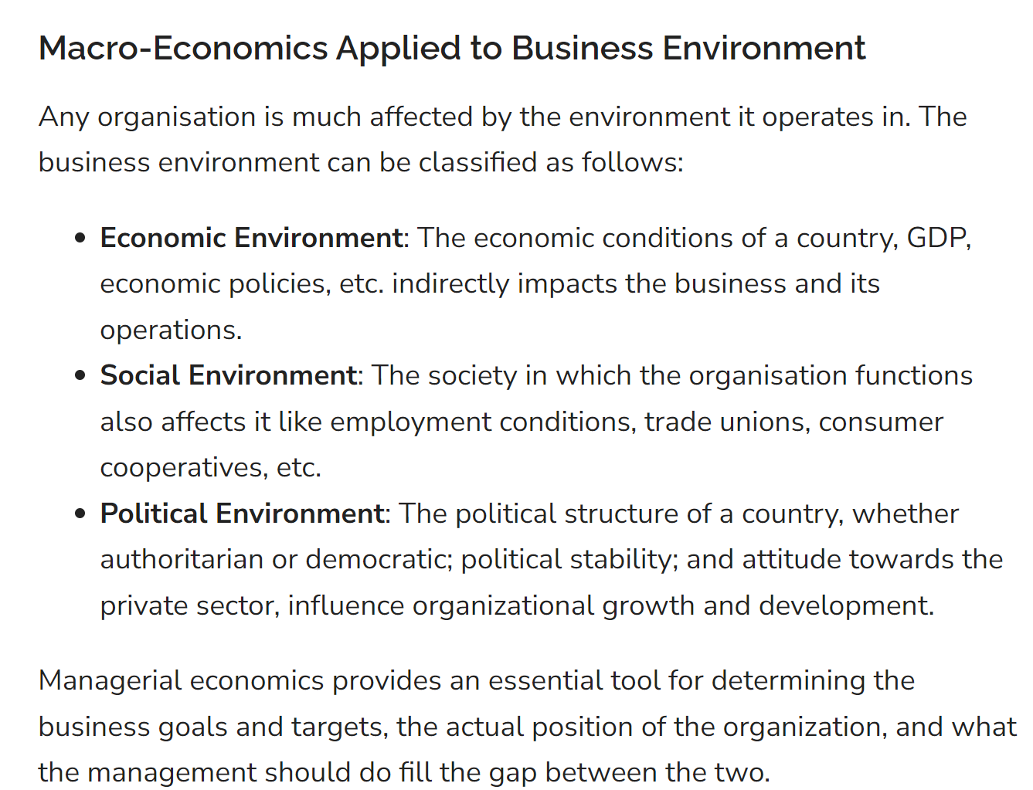

Slide 9
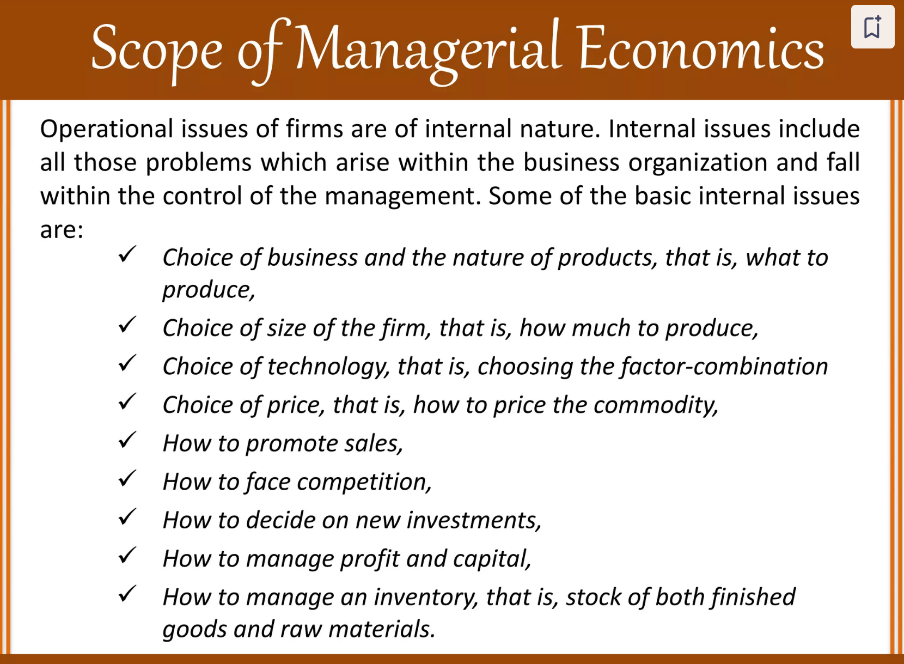

Slide 10
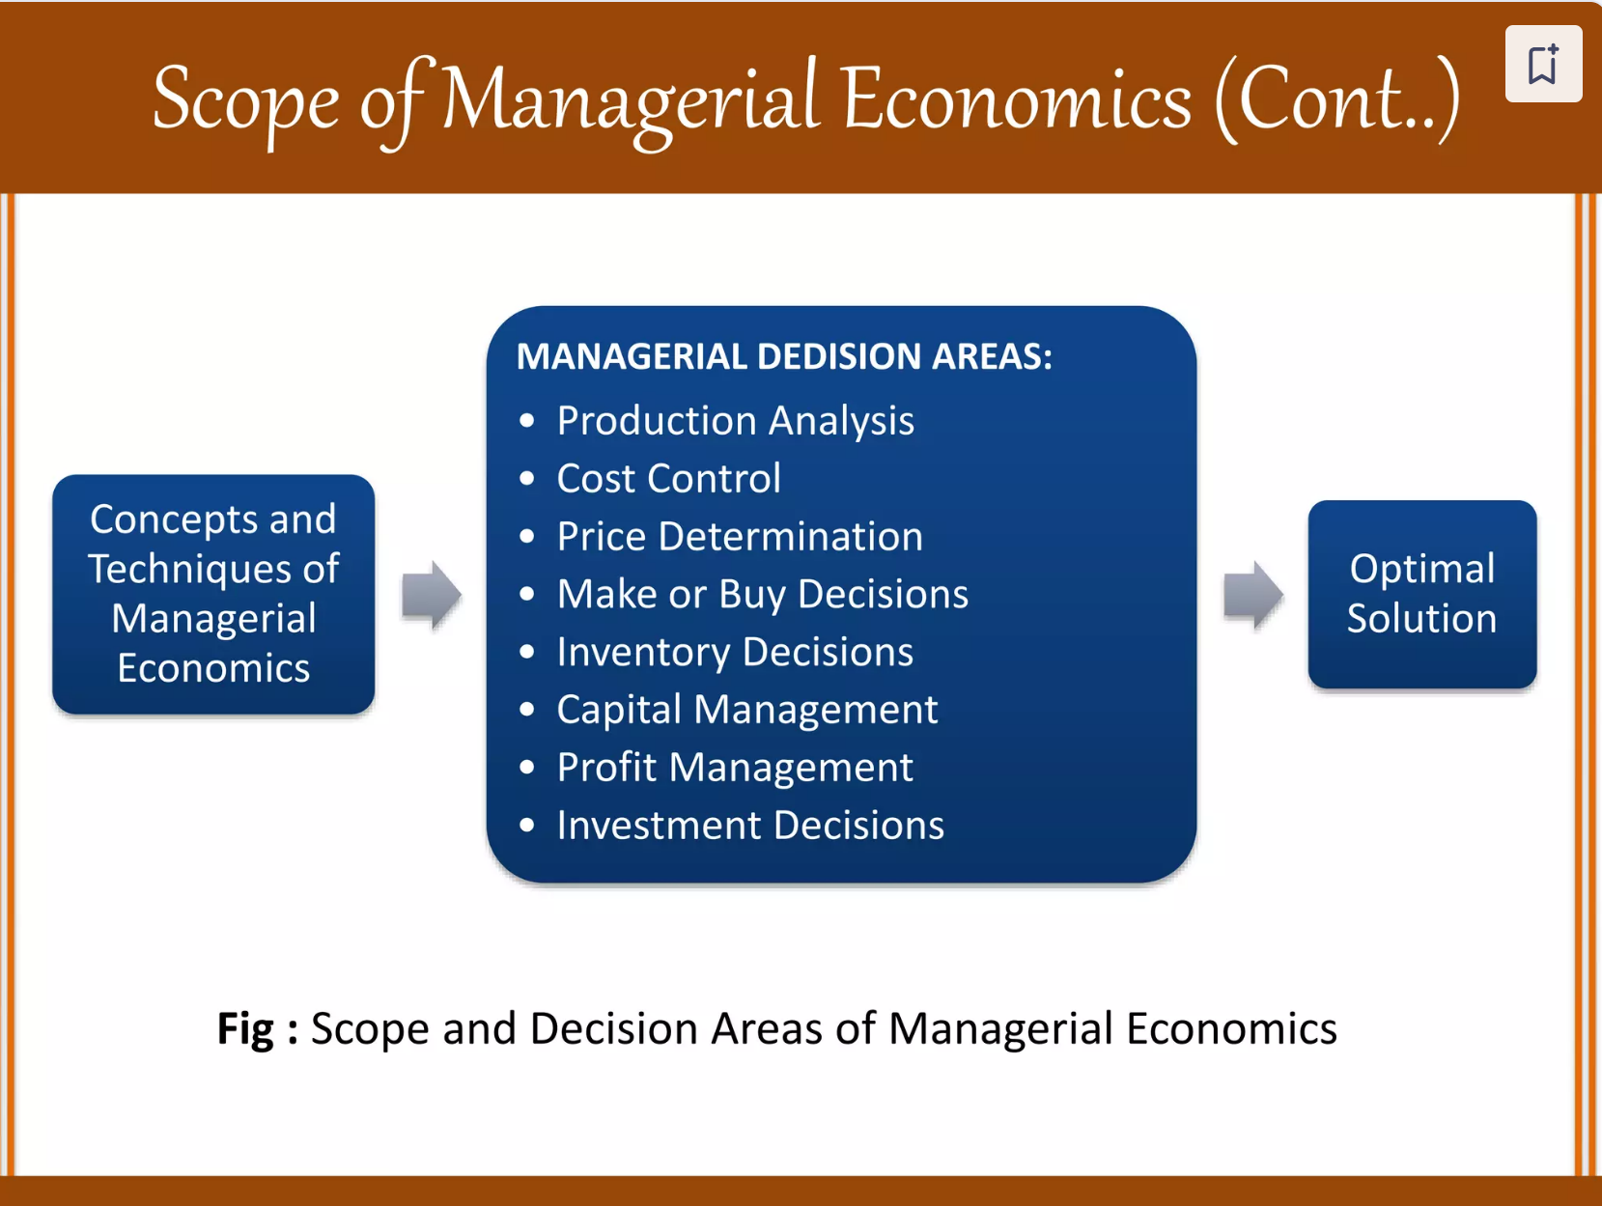

Slide 11
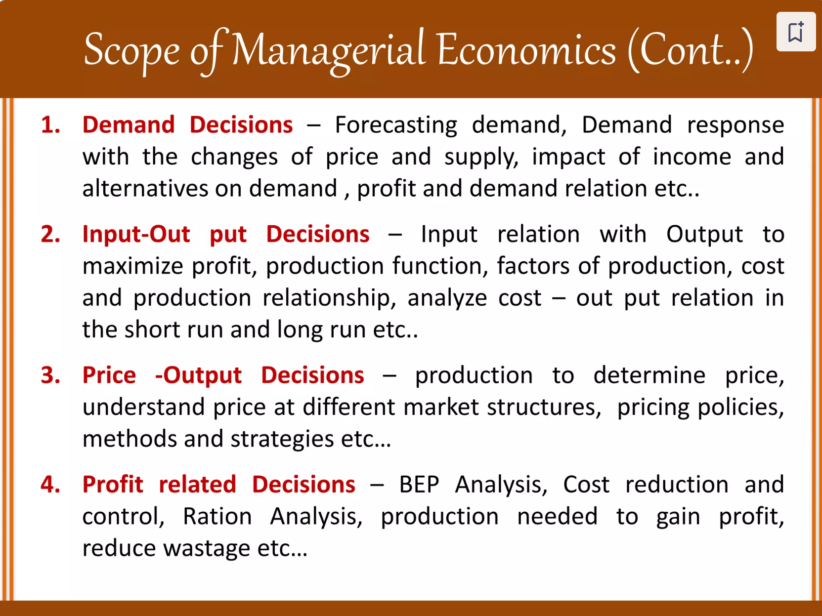

Slide 12
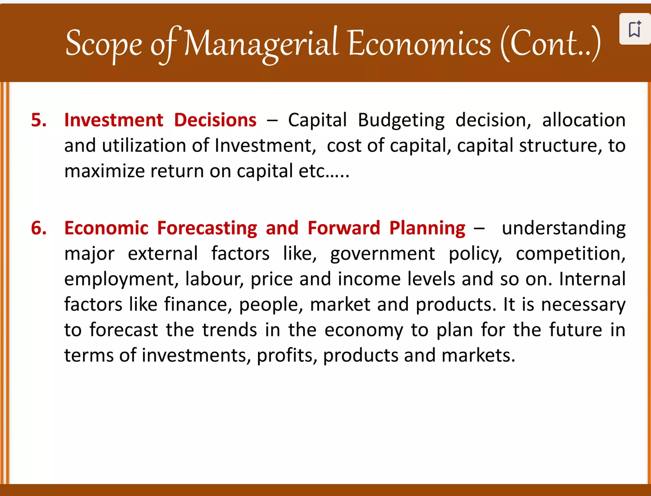

Slide 13


Slide 14
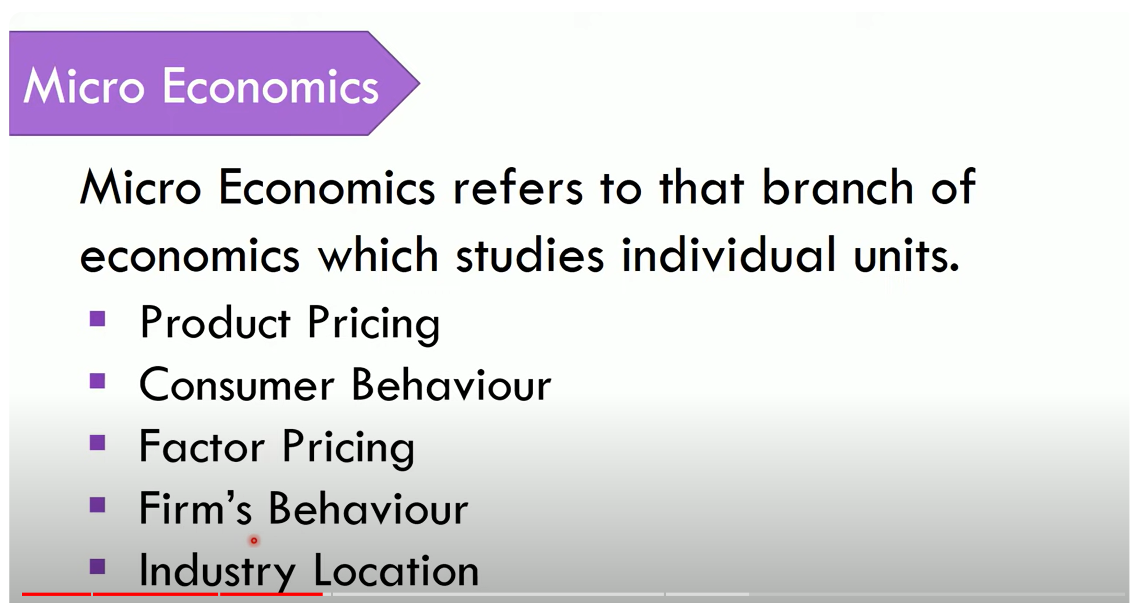

Slide 15
Microeconomics may be defined as the branch of economic analysis which studies about the economic behaviour of individual economic unit may be a person, a particular households, a particular firm and an industry.
The main objective of micro – economics is to explain the principles, problems and policies related to the optimum allocation of resources.
According to K. E. Boulding, ―Microeconomics is the study of particular firm, particular households, individual price, wage, income of the industry and particular commodity‖

Slide 16
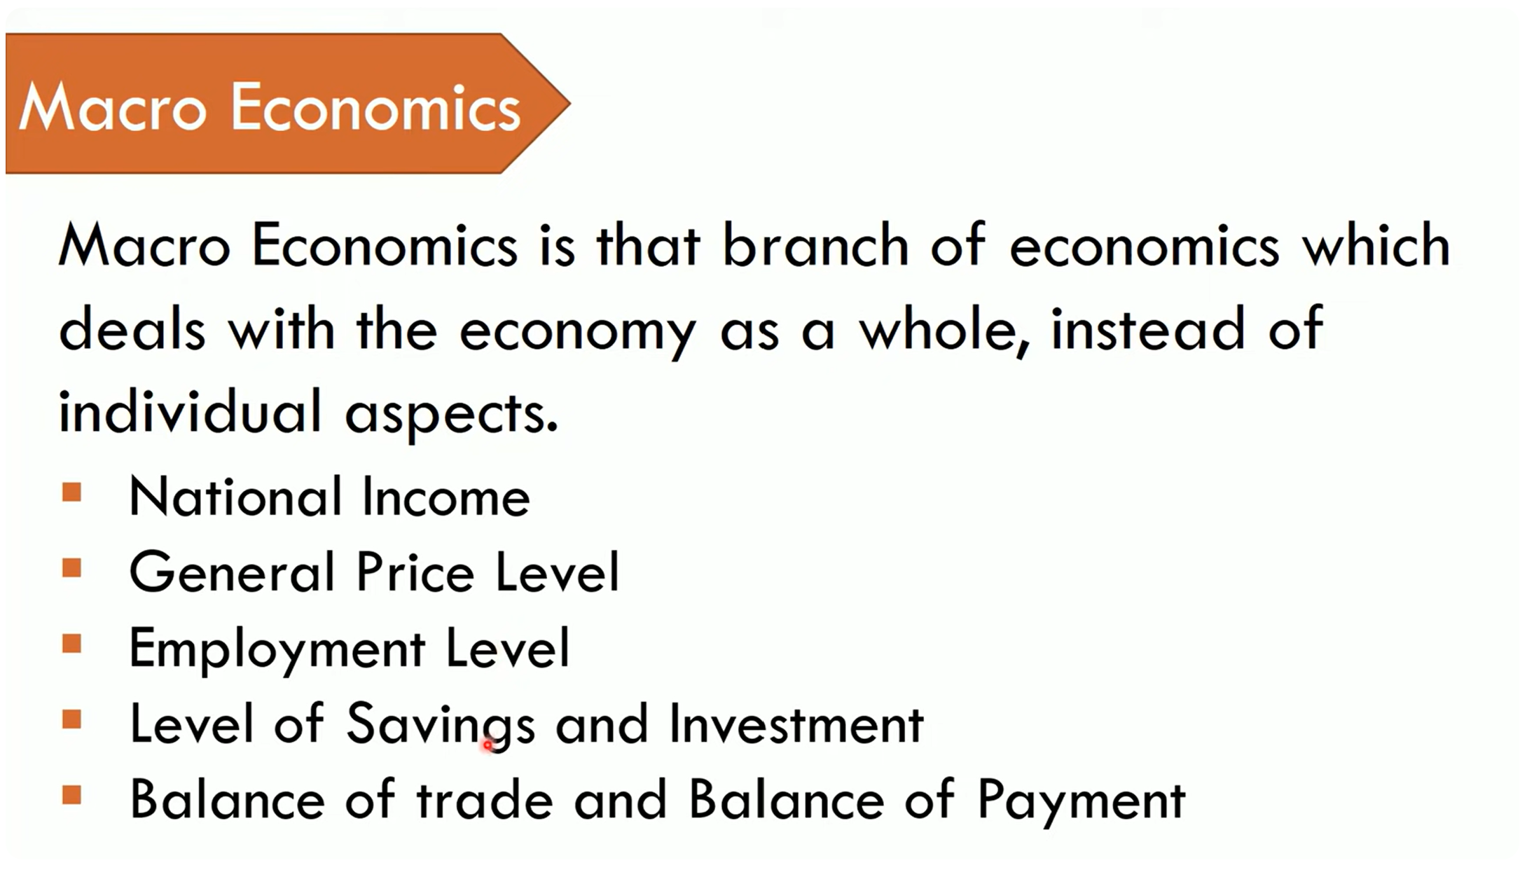

Slide 17
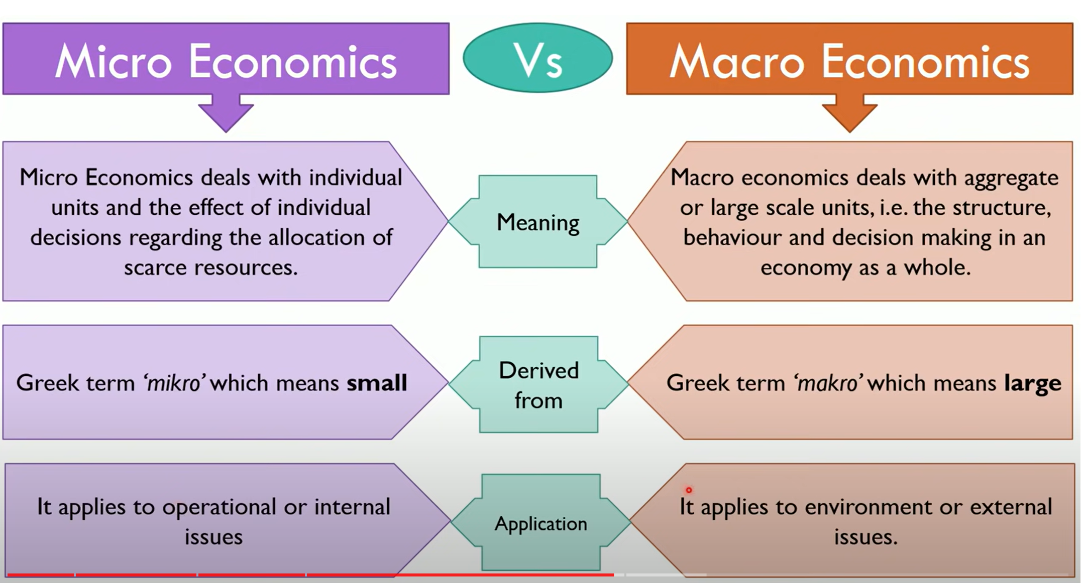

Slide 18
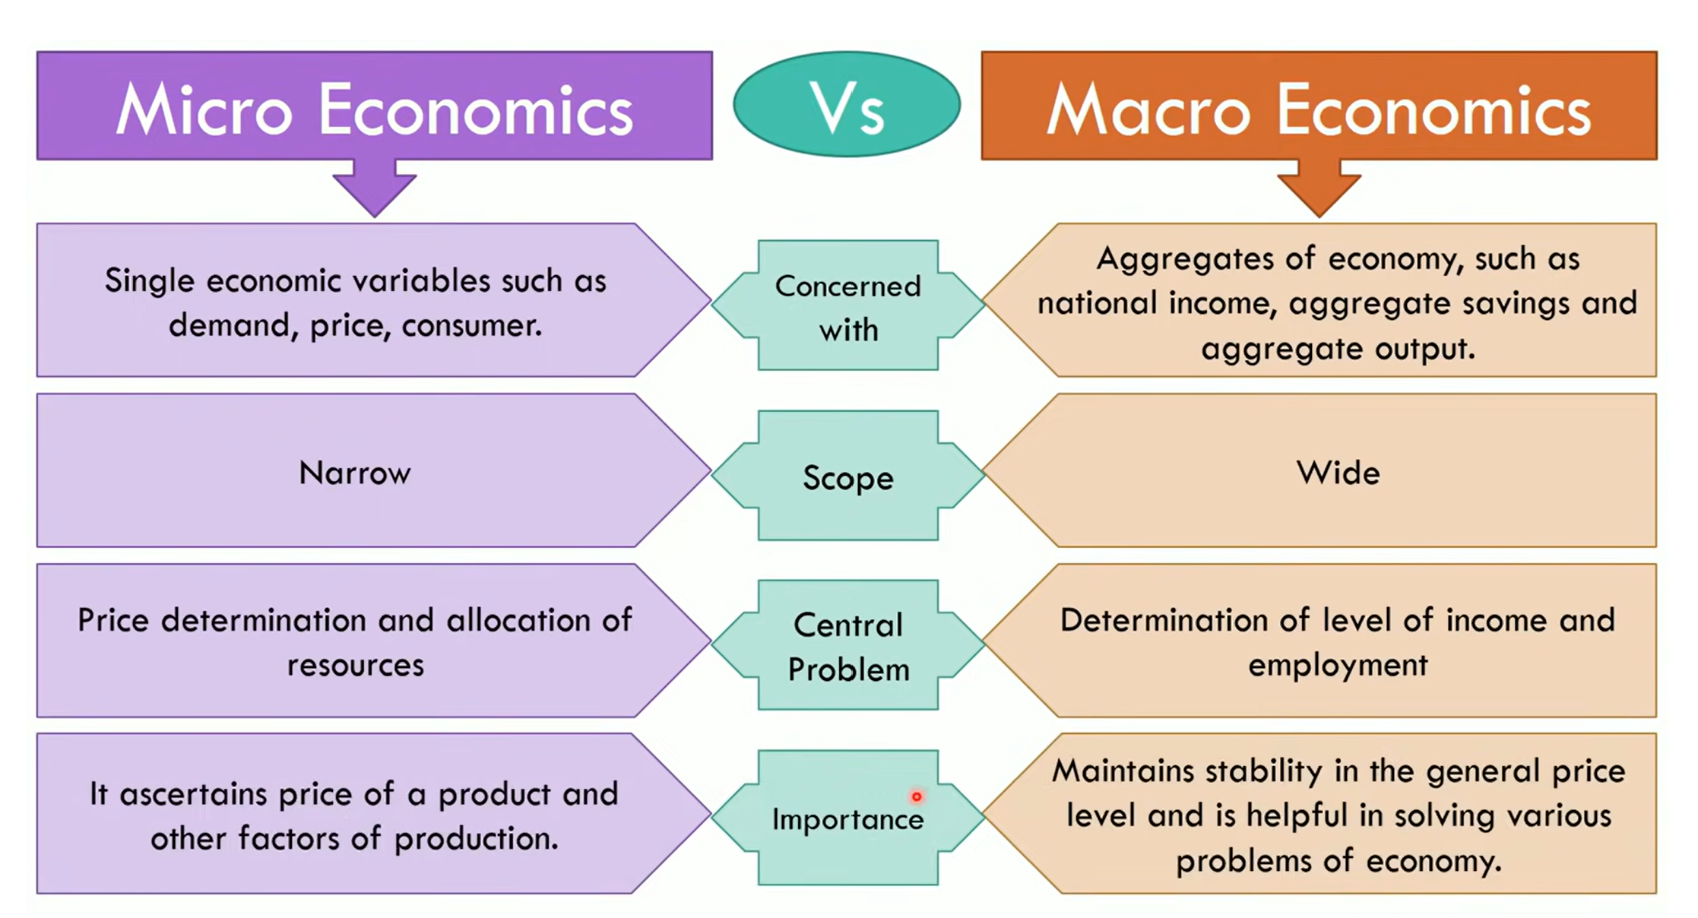

Slide 19
ENVIRONMENTAL SCANNING
Environmental scanning is a vital part of the corporate planning process. Effective planners try to anticipate what is likely to happen or attempt to influence the environment in favorable directions.
Environment literally means the surroundings external objects, influences or overall circumstances under which someone or something exists.
Environment literally means the surroundings external objects, influences or overall circumstances under which someone or something exists.

Slide 20
Why Environment Scanning:
The following examples summarise the purpose of environment scanning,
The banks and business enterprises in the public sector are being disinvested by the government
Computers have wiped out the market for typewriters and electronic typewriters
The advent of television channels has almost zeroed down the market for VCRs and significantly affected the flow of the film viewer traffic
Environment Analysis: Environmental Analysis is described as the process which examines all the components, internal or external, that has an influence on the performance of the organization. The internal components indicate the strengths and weakness of the business entity whereas the external components represent the opportunities and threats outside the organization.

Slide 21
INTERNAL AND EXTERNAL INFLUENCING BUSINESS ANALYSIS:
The different environment factors that affect the business can be broadly categorized as internal external factors,
INTERNAL FACTORS:
Internal factors those are that in premises with in organization, those are,
VALUE SYSTEM: It implies the culture and norms of the business, it other words, it means the regulatory framework of a business and every member of the organization has to act within the limits of this framework.
MISSION AND OBJECTIVES: Different priorities, policies and philosophies of business is guided by the mission and objectives of a business.
FINANCIAL FACTORS: Financial factors like financial policies, financial position and capital structure also affect a business performance and its strategies.
INTERNAL RELATIONSHIP: Factors like the amount of support the top management enjoys from its shareholders employees and the board of directors also effects the smooth functioning of a business.

Slide 22
EXTERNAL FACTORS:
SUPPLIERS: Suppliers are those people who are responsible for supplying necessary inputs to the organization and ensure the smooth flow of production.
COMPETITORS: Competitors can be called the close rivals and in order to survive the competition one has to keep a close look in the market and formulate its policies and strategies as such to face competition.
GLOBAL ENVIRONMENT:
Improving quality
Competition from MNCS, Capital and tech. transform
Deciding which monitors to enter and how to enter
Adjusting the mgt process
India and WTO
TECHNOLOGICAL ENVIRONMENT:
A Systematic application of scientific knowledge to practical task is known is technology. everyday there has been vast changes in products, services, lifestyles and living conditions, these changes must be analysed by every business unit and should adapt these changes

Slide 23
ECONOMIC ENVIRONMENT: It is very complex and dynamic in nature that keeps on changing with the changes in policies or political situations.
Economic conditions of Public
Economic Policies of the country
Economic system
Other Economic Factors: Infrastructural facilities, banking , insurance Money markets, Capital Markets etc.
POLITICAL ENVRONMENT:
Role of legislature, Role of executive, Role of judiciary constitution of India, new direction for government role.
SOCIO- CULTURAL ENVIRONEMENT:
These factors include: attitude of people to work, family system, caste system, religion, education, marriage etc.

Slide 24
PHASES / PROCESS OF BUSINESS CYCLE:

Slide 25
PHASES / PROCESS OF BUSINESS CYCLE: continue…
Prosperity/Expansion/Boom
Recession
Depression/Slump
Recovery

Slide 26
Stages of Product Life Cycle:

Slide 27
INFLATION- MEANING, TYPES OR KINDS OF INFLATION
INFLATION:
The price of goods and services are always changing. The chocolate one could buy for $1 a year back now costs $1.5. This is because of the increase in the price of commodities.
The phenomena when the prices of goods and services rise is known as inflation. It was first brought into light by the neo-classical economists, after which it has undergone modifications and it still remains a debatable term even today.
According to Parkin and Bade, “Inflation is an upward movement in the average level of prices. Its opposite is deflation, a downward movement in the average level of prices. The boundary between inflation and deflation is price stability.”

Slide 28
TYPES OR KINDS OF INFLATION:
The types of inflation have been classified on the basis of their varying nature. Generally, the basis of its classification is the rate of speed, cause, government reaction, and employment levels.
I. ON THE BASIS OF SPEED:
The different types of inflation on the basis of speed are explained below:
(i) Creeping/Mild inflation:
When the rise in price level is less than 3 percent per annum, it is termed as creeping or mild inflation. The price of goods and services rise moderately and it is usually considered helpful for the development of the economy. However, some economists consider it as a signal towards the rising prices.
(ii) Walking inflation:
A sustainable rise in price level within the range of 3 percent to 6 percent or less than 10 percent is called as walking inflation. It occurs when mild inflation is not considered or is let to fan out by the government.
Both creeping inflation and walking inflation are one digit figures and are considered as moderate inflation in the economy.
(iii) Running inflation:
When the rise in prices increase rapidly at a rate of 10 percent or 20 percent per annum is known as running inflation. As the inflation rate crosses two digit figure, economic problems arise. Running inflation adversely affects the poor and middle class families and households in the economy.
(iv) Hyperinflation:
Hyperinflation or galloping inflation is a rise in price level by 50 percent or more annually. It occurs when running inflation is left uncontrolled in the economy. When the economy faces hyperinflation, the preference of people shift from money to the traditional barter system.

Slide 29
II. ON THE BASIS OF EMPLOYMENT LEVEL
(i) Semi-inflation:
The rise in general price level below the level of full employment is termed as semi-inflation. According to Keynes, general prices do not rise as long as there are unemployed resources in the economy. However, when aggregate expenditure increases by a large portion, costs for some resources may rise eventually leading to increase in price. This phenomena is known as semi-inflation.
(ii) Pure inflation:
The inflation that occurs when the economy is at full employment level is known as pure inflation. As Keynes states, at full employment levels, output cannot be increased any further. Due to this, price level rises in relation to the rise in demand for commodities. This is termed as pure inflation.

Slide 30
III. ON THE BASIS OF GOVERNMENT REACTION:
(i) Open inflation:
When the government has no control over the price rise and there are no barriers to price rise, it is termed as open inflation. In this case, markets for commodities or factors or production are allowed to function freely with no intervention from the central authority.
(ii) Suppressed inflation:
When the government makes efforts to check the price rise through price control mechanisms, it is called as suppressed inflation. The government imposes various physical and monetary controls in order to suppress the extensive increase in price levels. Although control over price rise helps to keep inflation under check, it leads to price rise in uncontrolled resources, consequently resulting in diversion of productive resources. It may also lead to economic problems like hoarding of goods, black marketing, corruption, and so on.

Slide 31
IV. ON THE BASIS OF CAUSE:
(i) Demand pull inflation:
The rise in price due to excess demand for goods and commodities in comparison to their supply is termed as demand pull inflation. Classical economists state that the reason behind the rise in demand is because of the increased supply of money.
(ii) Cost push inflation:
The rise in the price level as a result of increase in the cost involved in the production of goods and services in known as cost push inflation. Cost of production may be caused due to the rise in price of raw materials, wages of workers, and so on.
For instance, the cost bread that costs $1 has risen to $1.5 in a month. This may have occurred because of the increase in the price of wheat or because of the higher wages demanded by workers in a baking company.
(iii) Deficit-induced inflation:
An economy faces deficit balance when its expenditures exceed revenue. In order to meet the gap, the government prints more money through central bank. So, any price rise in the economy due to the government’s effort to level of the deficit balance is called as deficit-induced inflation.
(iv) Credit inflation:
When financial institutions and commercial banks provide more loan to the public with a view to earn more profit, the amount of money in the economy exceeds more than what is required. The expansion of credit leads to rise in price level and is termed as credit inflation.

Slide 32
CAUSES OF INFLATION
1. Increase in money supply:
2. Deficit financing:
3. Increase in government expenditure:
4. Inadequate agricultural and industrial growth:
5. Rise in administered prices
6. Rising import prices
7 Rising taxes

Slide 33
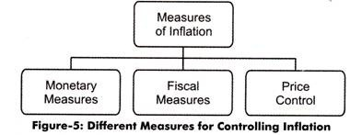
Measures of inflation

Slide 34
DEFLATION:
Deflation is a general decline in prices for goods and services, typically associated with a contraction in the supply of money and credit in the economy. During deflation, the purchasing power of currency rises over time.
Deflation
is a long-term decline in asset and consumer prices. A sustained decline in demand is what is actually responsible for the widespread deflation. Deflation is also called negative inflation. When the cost of goods and services rises, it is considered inflation, whereas when they fall, it is considered deflation.

Slide 35
EFFECTS OF DEFLATION:
Deflation can damage the economy severely. There have been cases where countries never recovered from this economic condition. Some of the major impacts seen in the economy as a result of deflation are stated below:
(i) Change in customer spending pattern:
Falling prices often has an unfavorable impact on the spending pattern of consumers. It encourages people to delay their purchases because of the expectation of further price fall in the future.
Demand for luxury goods such as TV or car reduces because people wait for the commodities to become cheaper. Thus, deflation leads to lower consumer spending.
(ii) Cyclical unemployment:
Deflation occurs due to fall in aggregate demand in the economy. This leads to business firms reducing their output levels which results in laying off of labors. As consumers delay spending while waiting for the prices of commodities to fall, economic activities decline, and this gives rise to unemployment.
(iii) Decline in business revenue:
Business firms significantly reduce prices of the produced commodities in order to stay competitive against the falling prices in the economy. Subsequently, revenues earned by these firms start declining.
(vi) Increase in real value of debt:
During the period of deflation, debtors face a difficult time in paying off their debts. Business firms as well as individuals have to give up larger portion of their disposable income for debt payment. This is because, during deflation, firms are likely to earn less profit, and individuals face the problem of lower wages rates. Thus, deflation increases the real value of money and the real value of debt.

Slide 36
CAUSES OF DEFLATION:
Deflation is often caused due to reduced supply of money. But, it may also result due to a decline in personal, governmental, or investment spending. There are other economic factors that lead to the phenomena of declining prices. Some of the factors contributing to deflation are stated below:
(i) Increased productivity of the firms:
Businesses and manufacturing firms become more productive through new and innovative processes of production. As efficiency increases, the stock level of goods and commodities increases. To sell more and reduce stock levels, producers reduce the price level of goods and services. This may have a profound effect on the entire economy, leading to deflation.
(ii) Decrease in money supply:
Deflation occurs when money supply is slower than the supply of commodities. Prices decline because there is limited money flow in the economy. So, business firms accept lower prices for goods and services in order to earn as much as they can.
(iii) Fall in aggregate demand:
Aggregate demand falls when people demand less of the goods and services. This occurs when people hoard money with an expectation of further rise in the value of money. Producers are thus forced to reduce the price of commodities in order to avoid profit decline and piling up of inventories. This results in deflation in the economy.
(iv) Change in structure of capital markets:
To compete in a market, producers try to sell their products at a lower price than their competitors. The increase in demand can help them get a return on their investment later, but this needs more investment to begin with.

Slide 37
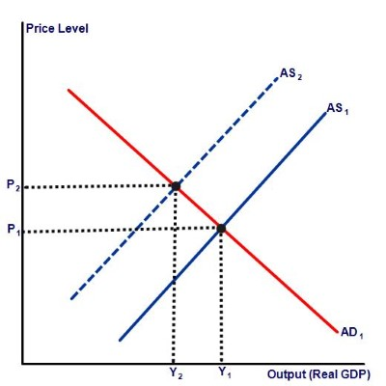
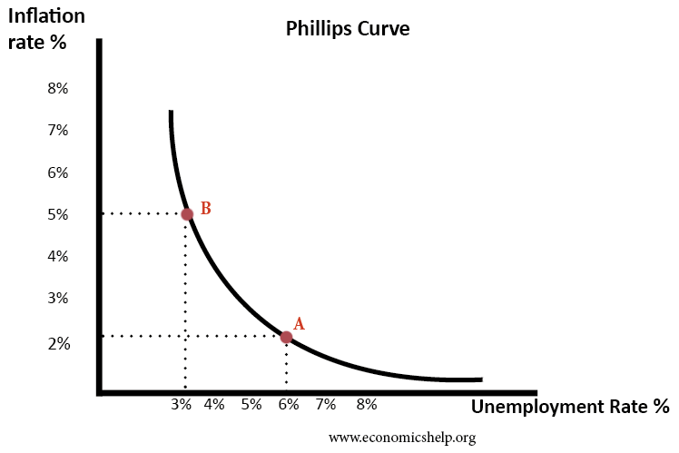

Slide 38
CAUSES OF STAGFLATION:
Economists have identified two major explanations for the occurrence of stagflation. They believe that stagflation occurs as a result of supply side shock, and inappropriate macroeconomic policies.
(i) Supply side shock:
Stagflation occurs when productive capacity of an economy reduces due to supply side shock. Supply shock is the unfavorable disturbances in the supply chain due to rise in price of goods.
For instance, increase in prices slows down economic growth by affecting production and producers. When cost of production becomes high, production itself becomes costly and reduces profit levels of the manufacturing firms.
(ii) Inappropriate macroeconomic policies:
Stagflation and inflation can occur simultaneously because of inappropriate macroeconomic policies.
For instance, the excess of money supply in the market leads to inflation. This happens when the central authority allows more cash in the economy. Similarly, when government imposes excessive regulation over goods and labor markets, it results in stagnation.

Slide 39
STAGFLATION – PHILIPS CURVE
Stagflation is an economic cycle in which there is high rate of inflation and stagnation. Inflation is when prices of commodities are at an increasing state. Stagnation occurs when an economy faces slow economic growth rate (decline in production).

Slide 40
National income
National income is referred to as the total monetary value of all services and goods that are produced by a nation during a period of time.
In other words, it is the sum of all the factor income that is generated during a production year. National income serves as an indicator of the nation's economic activity.
According to Marshall: ―The labour and capital of a country acting on its natural resources produce annually a certain net aggregate of commodities, material and immaterial including services of all kinds. This is the true net annual income or revenue of the country or national dividend.
‖ In this definition, the word ‗net‘ refers to deductions from the gross national income in respect of depreciation and wearing out of machines. And to this, must be added income from abroad.

Slide 41
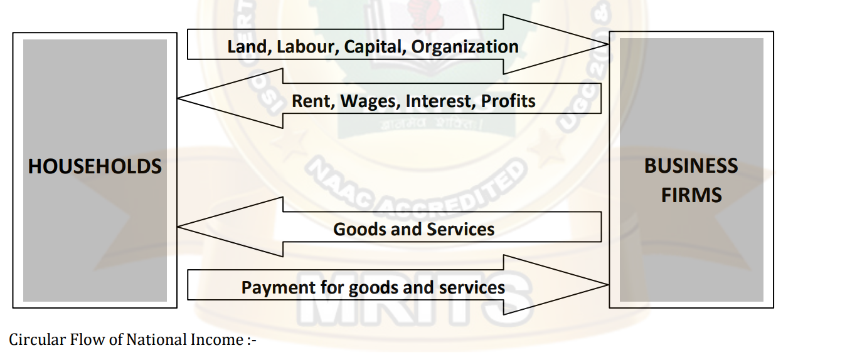
Circular flow of national income
The expenditure of one person is the income of another person, and his expenditure is also equal to value of goods and services. To explain this idea we assume that there is economy where are only two sectors in the economy. 1. Firms. 2. Households.

Slide 42
CONCEPTS OF NATIONAL INCOME
Gross Domestic Product(GDP)
Gross domestic product- the market value of all final goods and services produced in a country during a specific period of time which is usually one year.
GDP is measured using market values, and not quantities. Production is measured in quantities, but then those quantities have to be changed to account for their value. In economics we use prices to place values on the final goods, so total production times price will give us the total value.
Final goods and services vs intermediate goods or services. Intermediate product sa re used as an input to produce another good or service such as sugar being purchased to make soda. Sugar is an intermediate good, while soda is a final good.
GDP = C + I + G + NX consumption expenditure (C) , investment expenditure (I) government expenditure (G) plus net exports (NX = Exports - Imports).

Slide 43
2. Gross National Product (GNP)
Gross National Product is the total market value of all final goods and services produced annually in a country plus net factor income from abroad. Thus, GNP is the total measure of the flow of goods and services at market value resulting from current production during a year in a country including net factor income from abroad. The GNP can be expressed as the following equation:
GNP=GDP+NFIA
NFIA-(Net Factor Income from Abroad)
NFIA = Income earned by Indians in abroad through jobs or businesses –Income earned by foreigners in India by jobs or businesses.

Slide 44
3. Net National Product(NNP):Net National Product is the market value of all final goods and services after allowing for depreciation. It is also called National Income at market price. When charges for depreciation are deducted from the gross national product, we get it.
Thus, NNP=GNP-Depreciation
4. National Income (NI) National Income is also known as National Income at factor cost. National income at factor cost means the sum of all incomes earned by resources suppliers for their contribution of land, labor, capital and organizational ability which go into the years net production. Hence, the sum of the income received by factors of production in the form of rent, wages, interest and profit is called National Income. Symbolically,
NI=NNP + Subsidies given by Govt. - Indirect Taxes

Slide 45
5. Personal Income (PI): is the total money income received by individuals and households of a country from all possible sources before direct taxes. Therefore, personal income can be expressed as follows:
PI=NI-Corporate Income Taxes-Undistributed Corporate Profits-Social Security Contribution + Transfer Payments
6. Disposable Income (DI) The income left after the payment of direct taxes from personal income is called Disposable Income. Disposable income means actual income which can be spent on consumption by individuals and families. Thus, it can be expressed as:
DI=PI-Direct Taxes
7. Per Capita Income (average income) of a country is derived by dividing the national income of the country by the total population of a country. Thus,
PCI=Total National Income/Total National Population

Slide 46
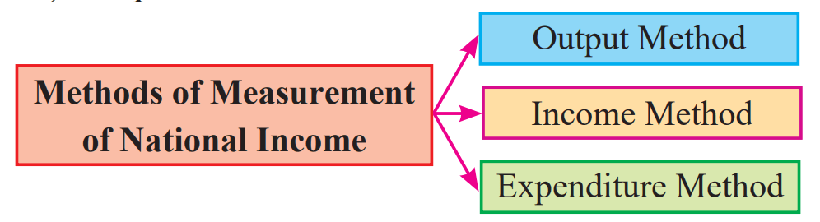

Slide 47
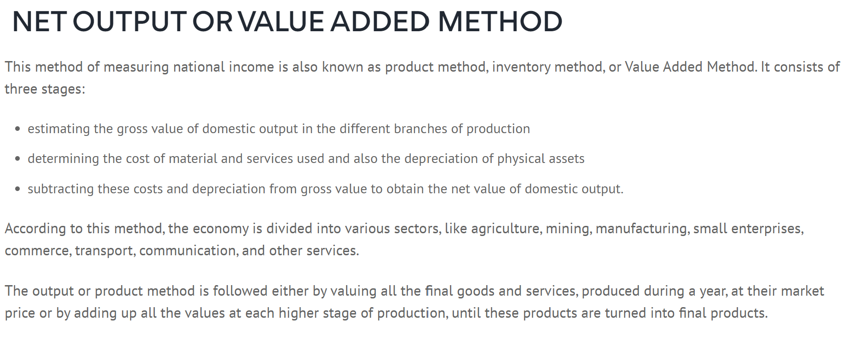
GNP=P1Q1+P2Q2+---------+PnQn+Net income from abroad
GNP=Gross net product, P1+product Q1=Quantity

Slide 48
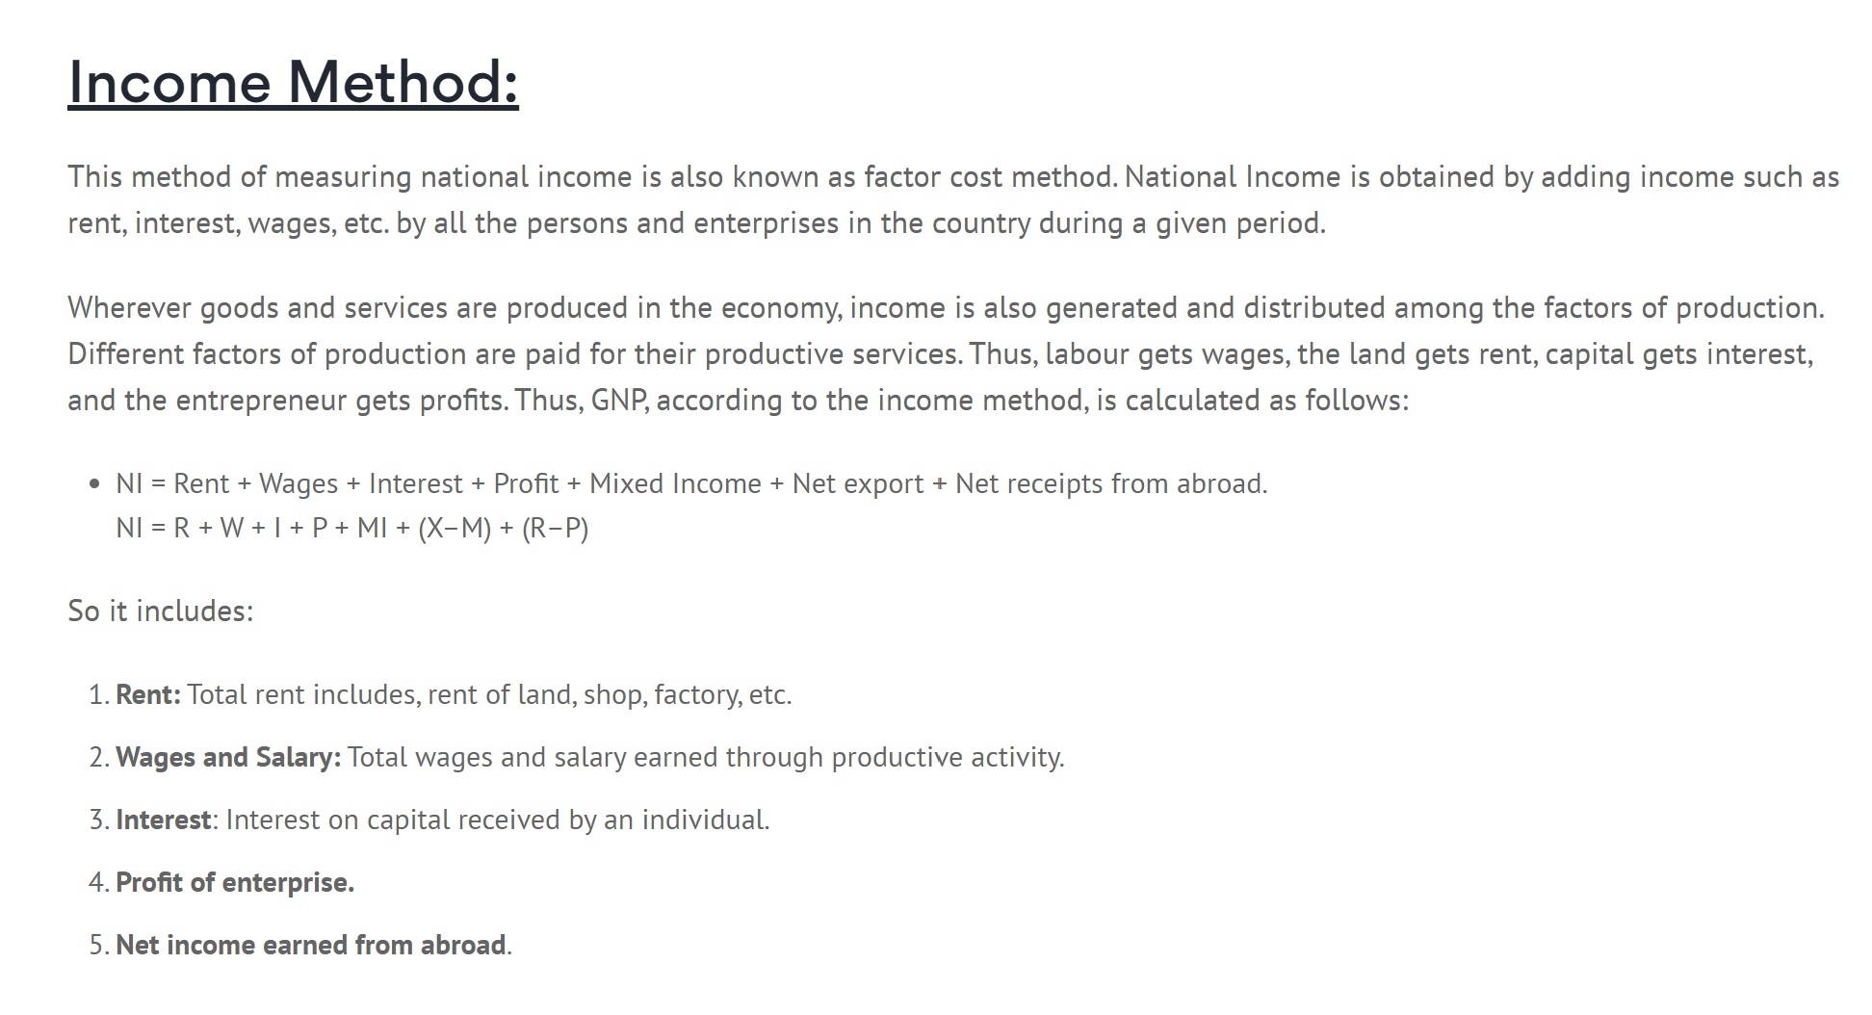

Slide 49
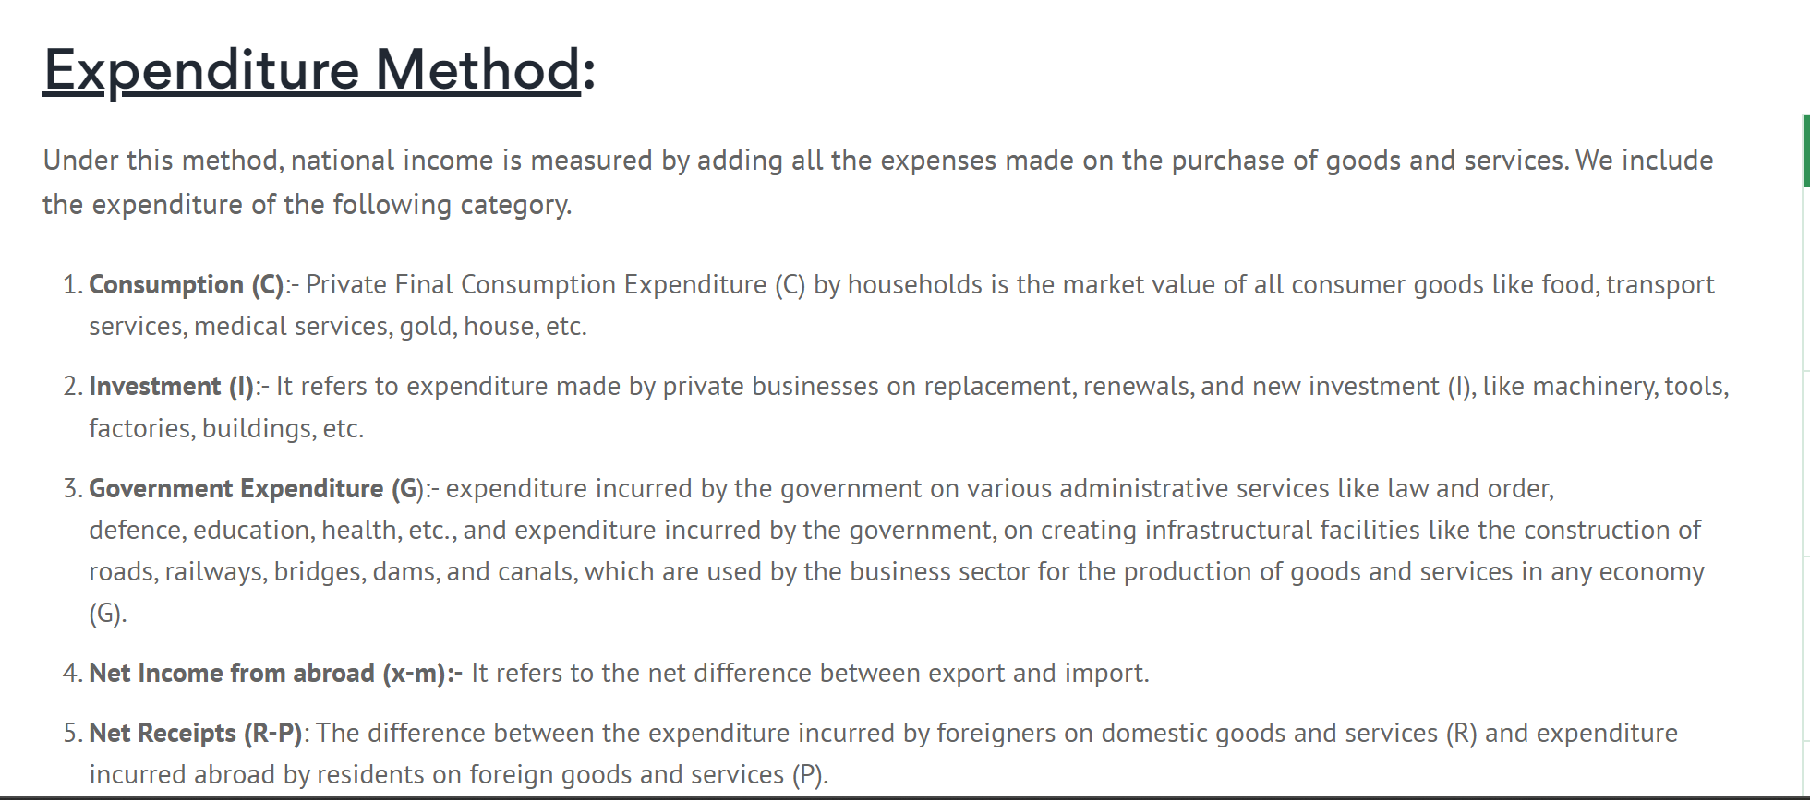
NI=EH+EF+EG+Net exports+Net receipts

Slide 50
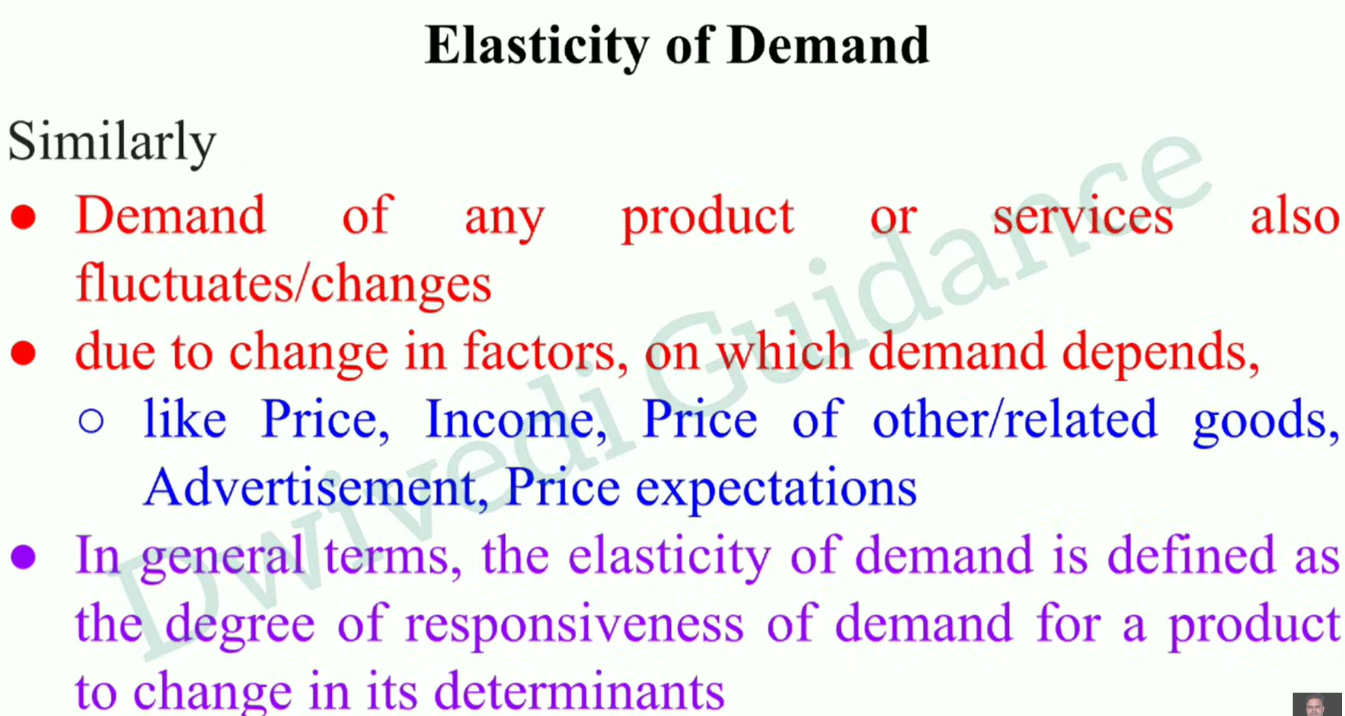

Slide 51
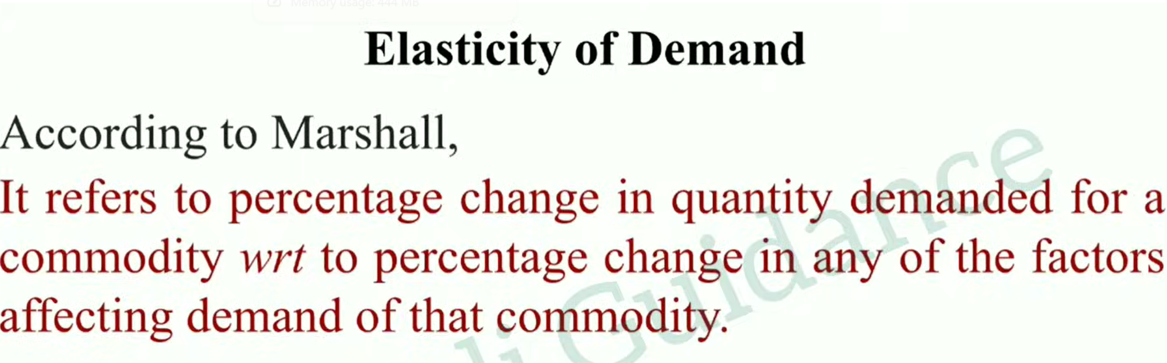

Slide 52
Measurement of elasticity of demand
The elasticity is measured in five types
Perfectly inelastic demand.
Perfectly elastic demand.
Unity elasticity.
Relatively elastic demand.
Relatively inelastic demand.

Slide 53
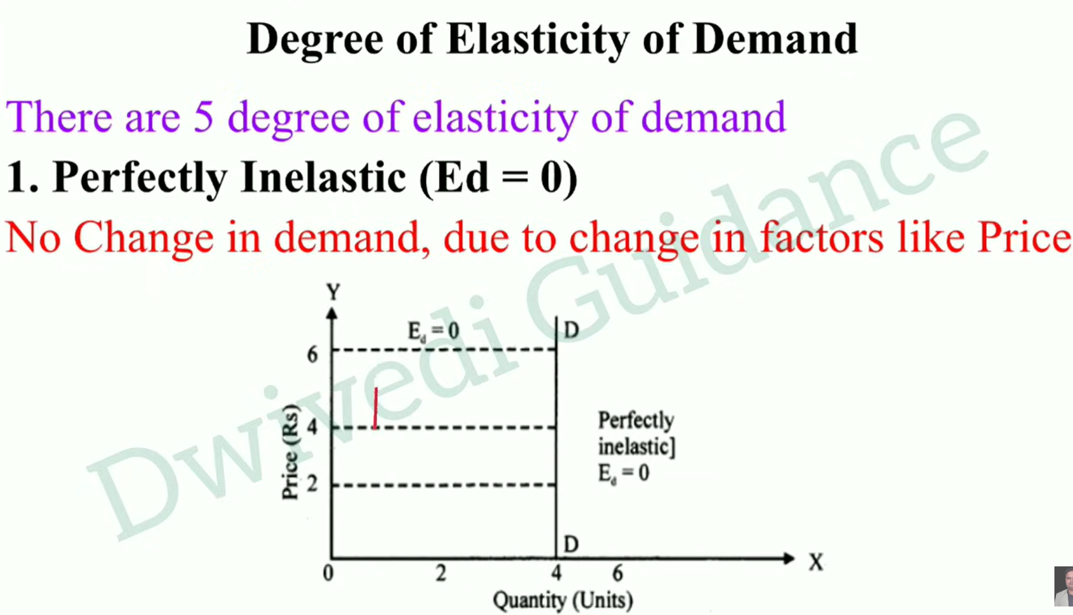

Slide 54
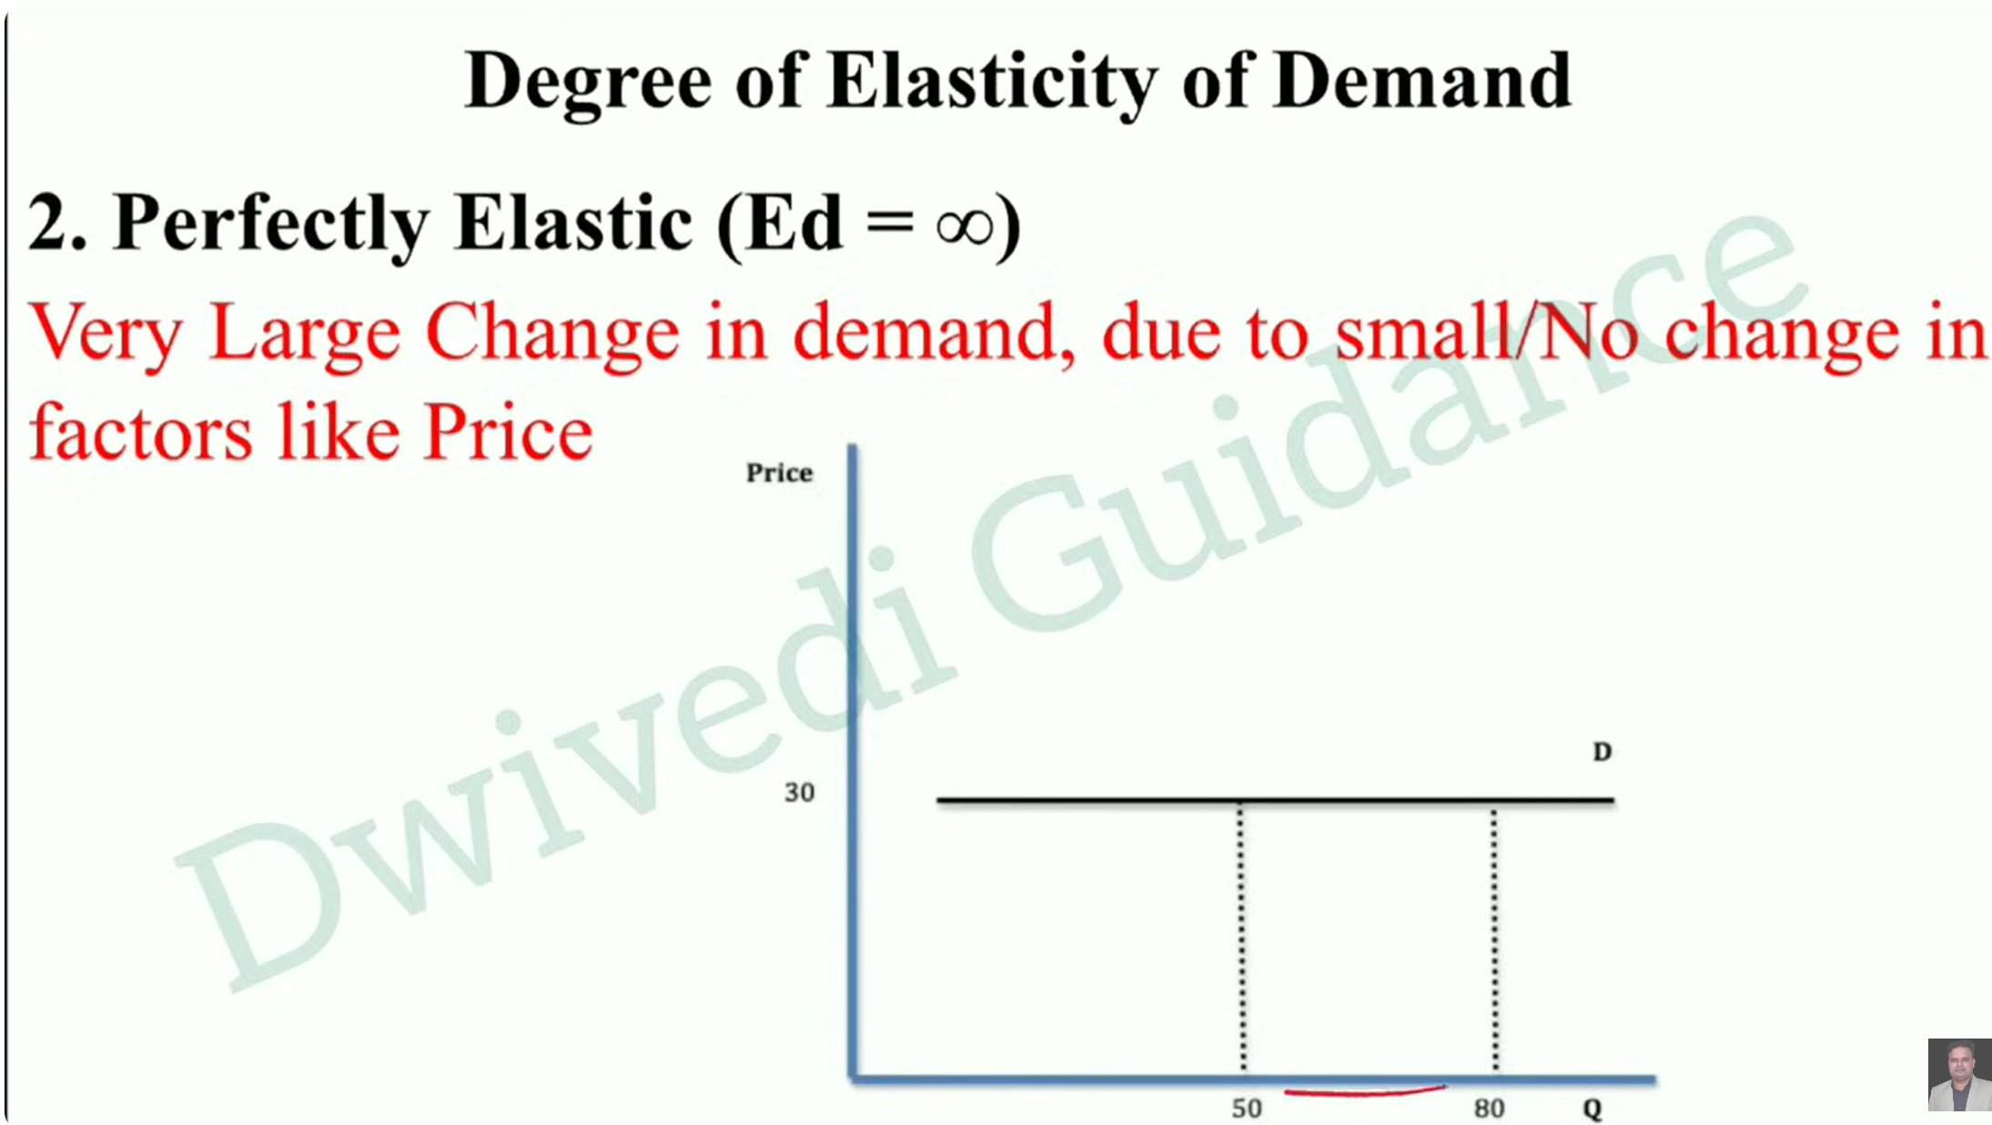

Slide 55
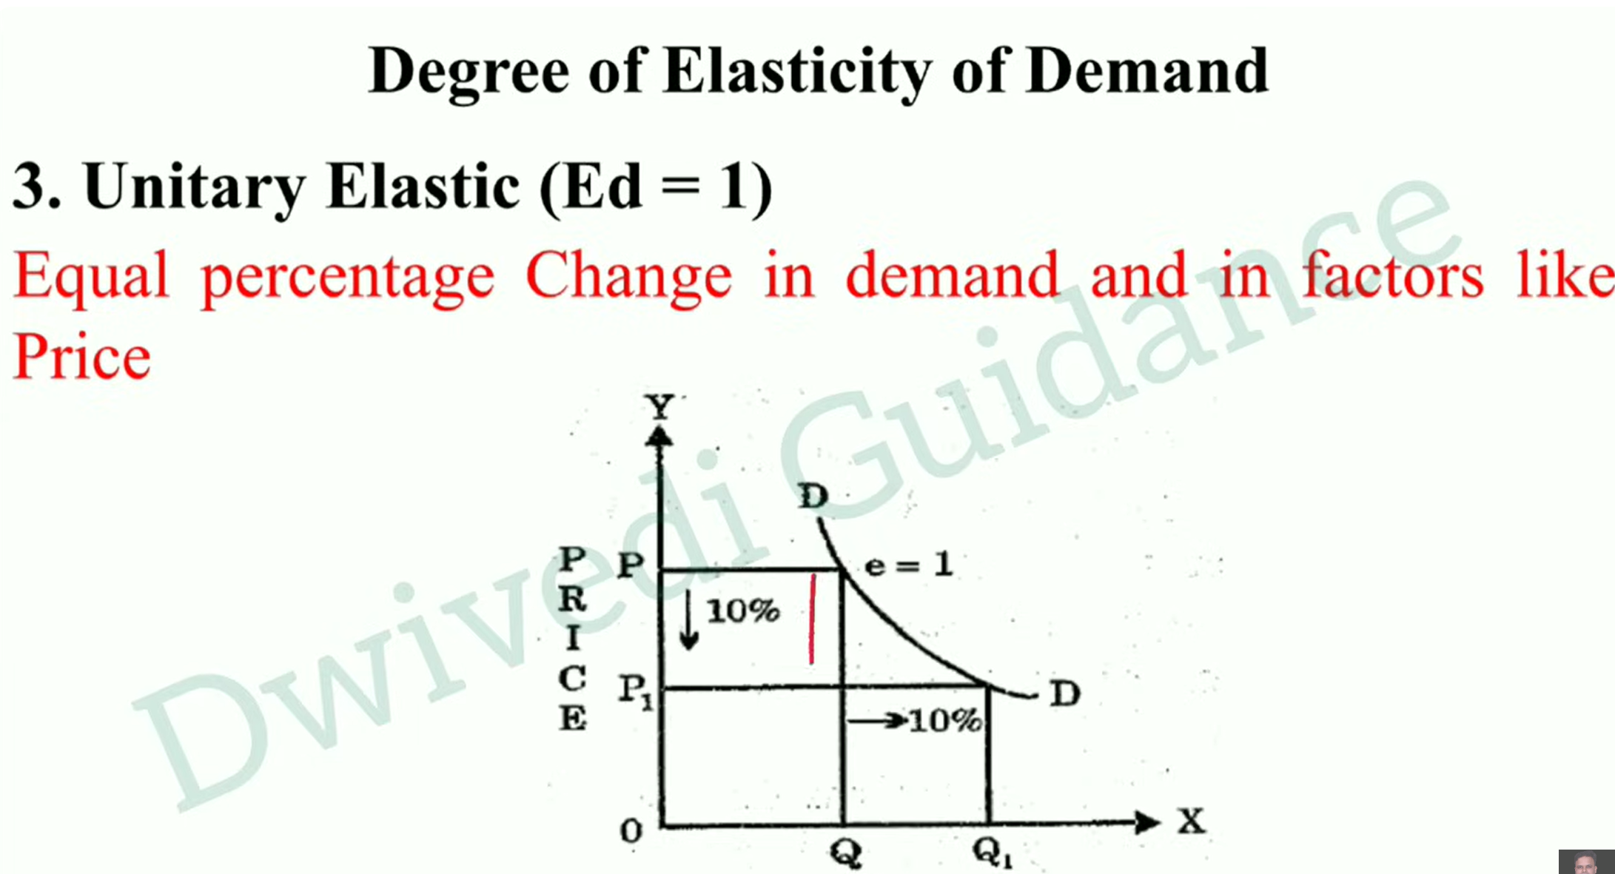

Slide 56
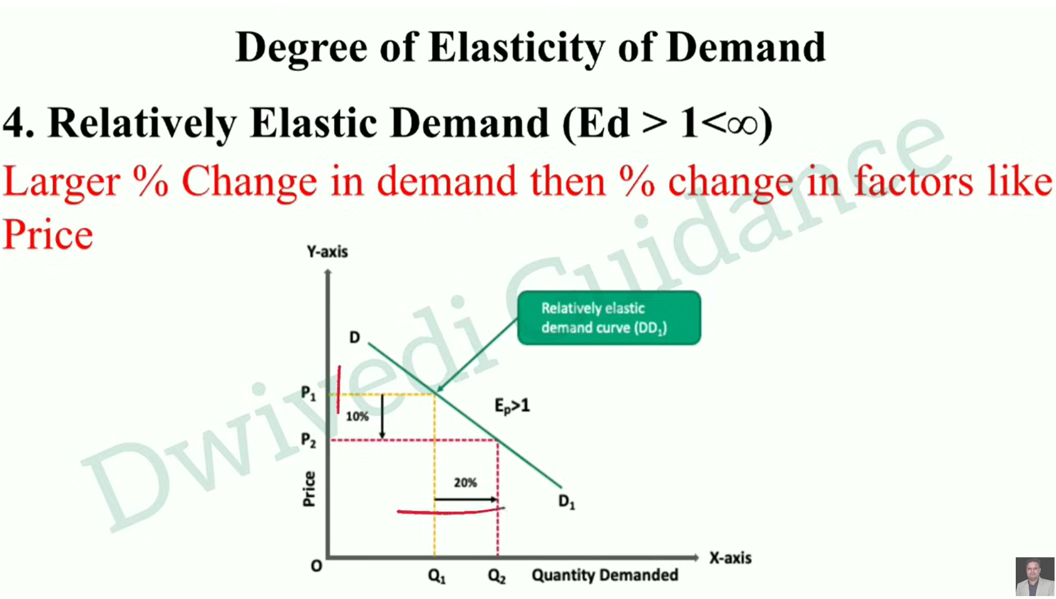

Slide 57
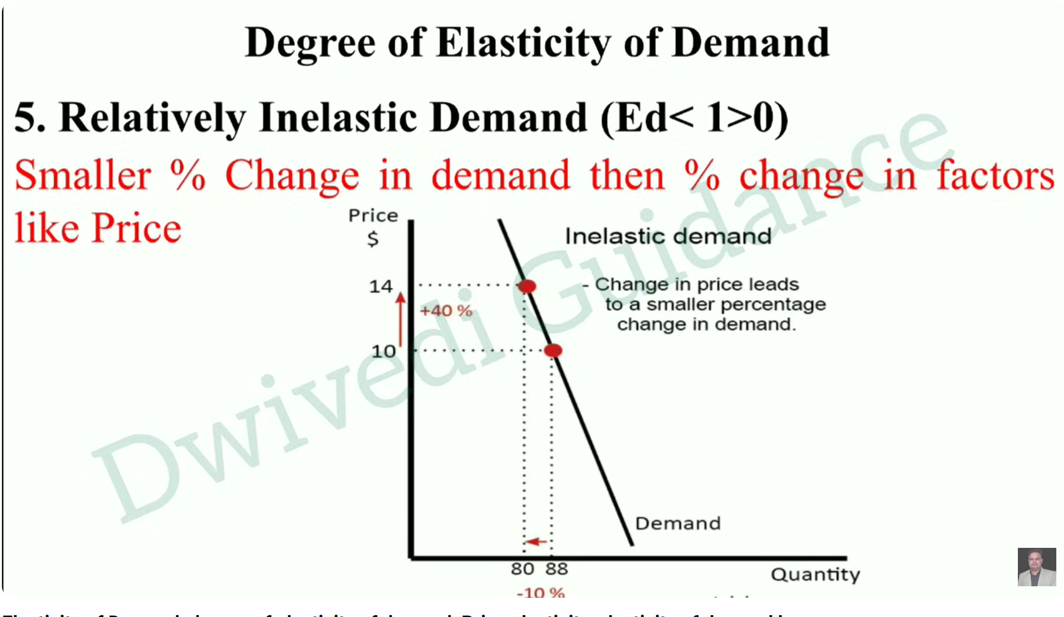

Slide 58
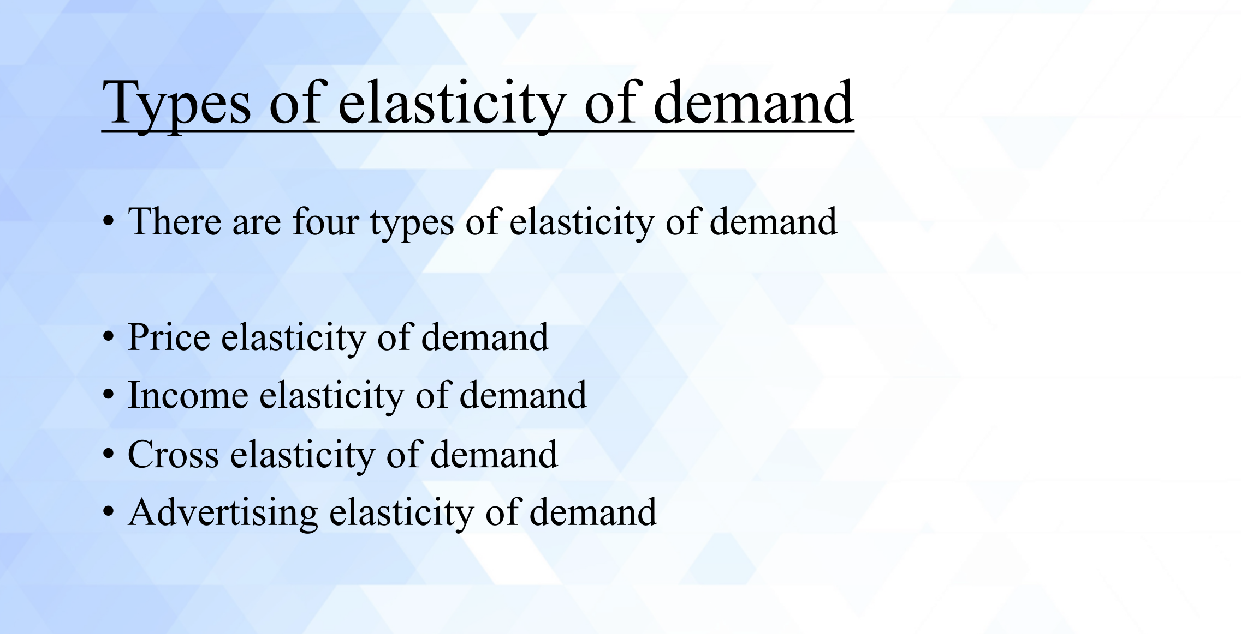

Slide 59
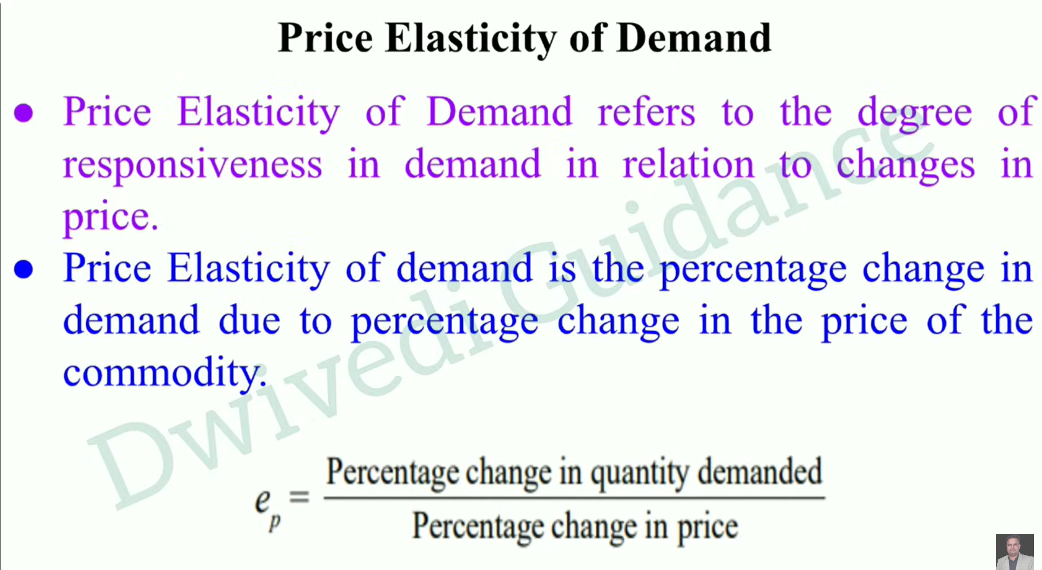

Slide 60
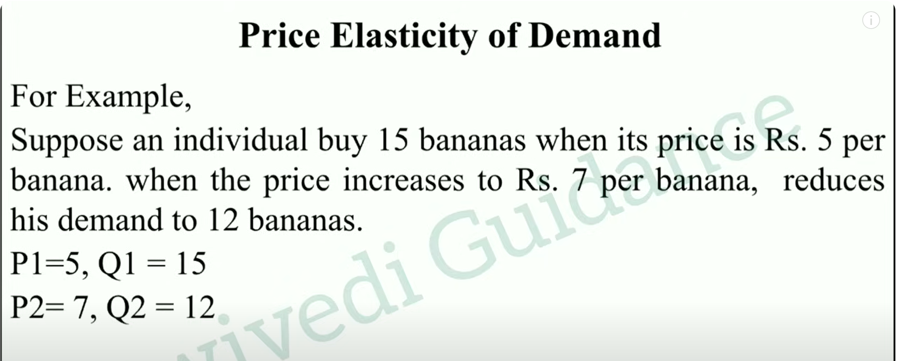

Slide 61
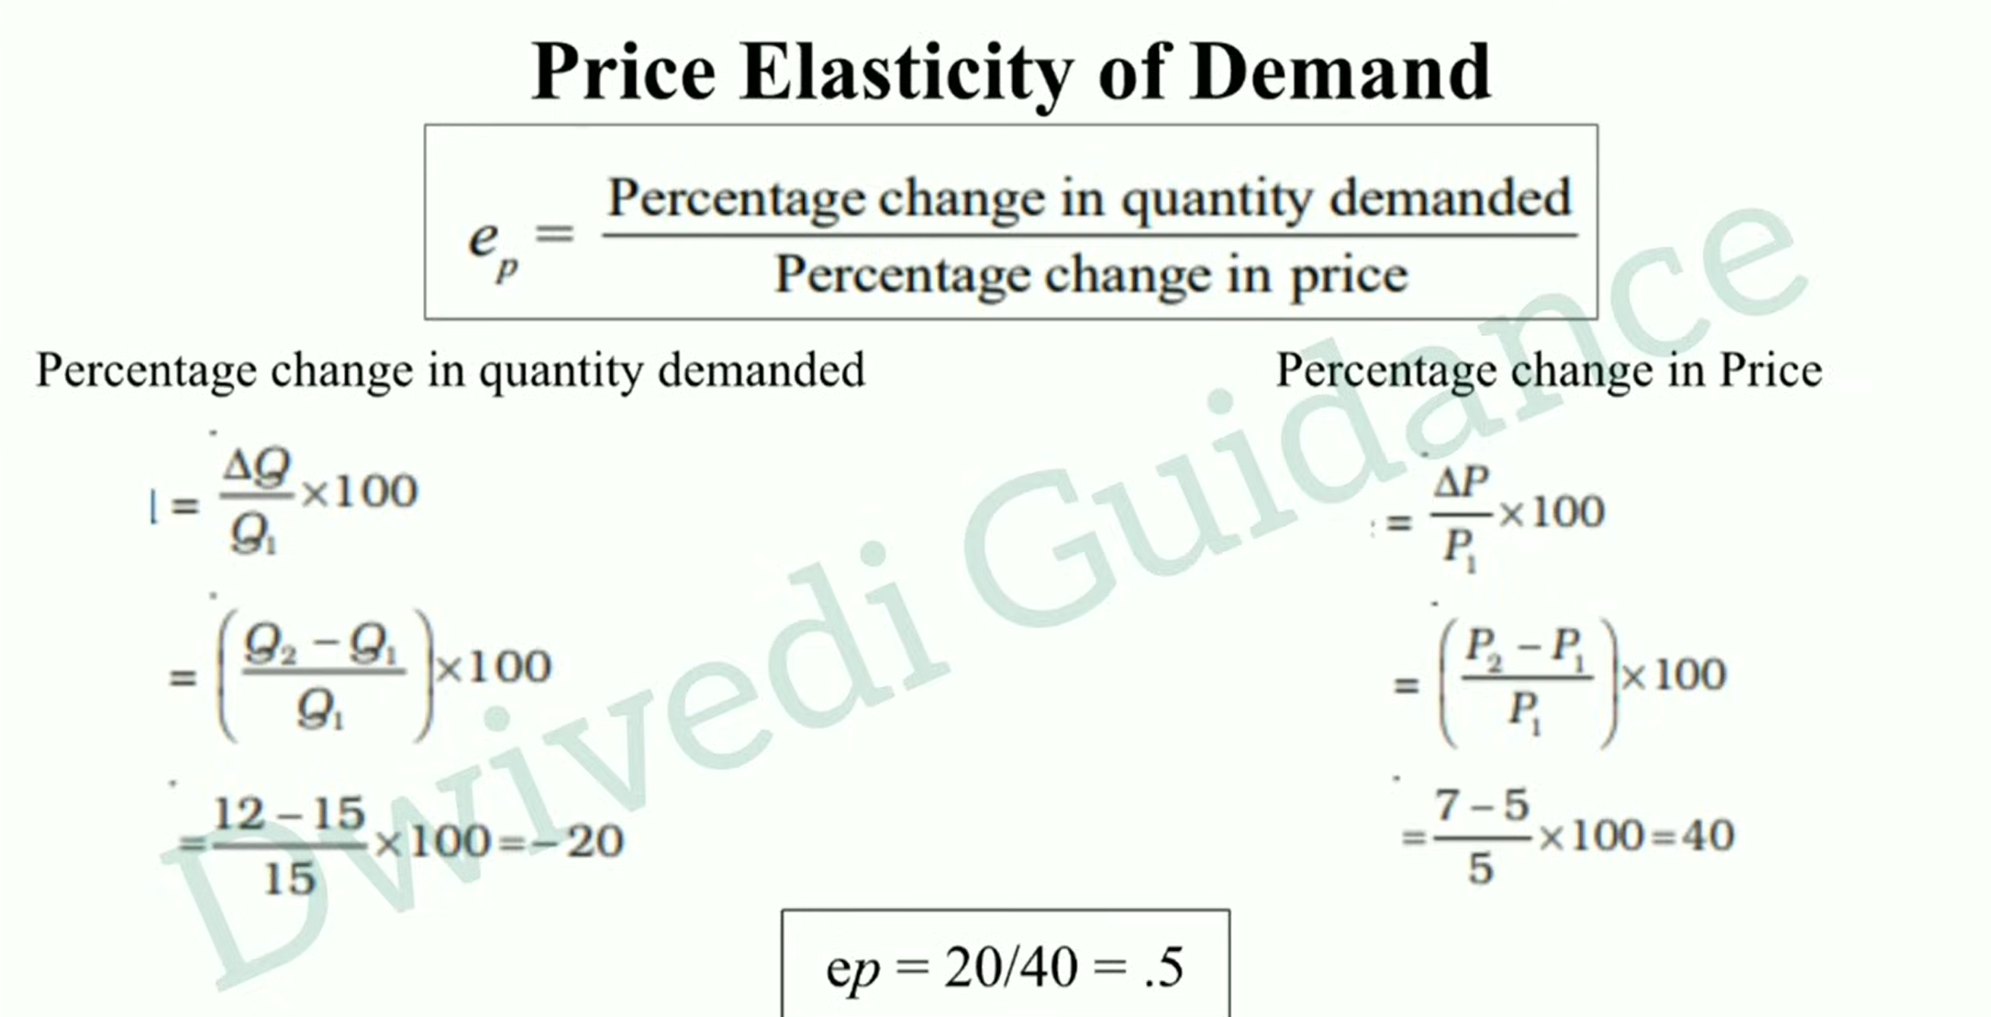

Slide 62
Price elasticity of demand
elasticity of demand in general refers to price elasticity of demand.
In other words, it refers to the quantity demanded of a commodity in response to a given change in price.
Price elasticity of demand is always negative, which indicates that the customer tends to buy more with every fall in the price. The relationship between the price and demand is inverse.
Price elasticity of demand formula:
= percentage change in the quantity demanded for product X Percentage change in the price of X

Slide 63
Price elasticity of demand
EDP = (Q2-Q1)/Q1
(P2-P1)/P1
Q1 is the quantity demanded before prize change. Q2 is quantity demanded after price change.
P1 is the price before change P2 the price after change
Price elasticity of demand divide into three types They are elastic price demand(ED > 1)
Inelastic price demand(ED < 1) Unity price elasticity(ED = 1)

Slide 64
Income elasticity of demand
Income elasticity of demand refers to the quantity demanded of a commodity in response to a given change in income of the customer.
Income elasticity is normally positive, which indicates that the customer tends to buy more and more with every increase in income.
Income elasticity of demand formula:
= percentage change in quantity demanded for product X Percentage change in income
EDI = (Q2-Q1)/Q1
(I2-I1)/I1
I1 is income before change
I2 is the income after change

Slide 65
Cross elasticity of demand
Cross elasticity of demand refers to the quantity demanded of a commodity in response to a change in the price of a related goods, which may be substitute or complement.
Cross elasticity of demand formula:
Percentage change in quantity demanded for product X Percentage change in price of product Y
EDC = (Q2-Q1)/Q1
_{(P2y-P1y)/P1y} • P1y is the price before change
P2y is the price after change in the case of product Y

Slide 66
Advertising elasticity of demand
There is a direct relationship between the amount of money spent on advertising and its impact on sales. advertising elasticity is always positive.
Advertising elasticity of demand formula:
= percentage change in quantity demanded for product X Percentage change in advertisement costs
EDA = (Q2-Q1)/Q1
A1 is the amount spent on advertisement before change
A2 the amount spent on advertisement after change
(A2-A1)/A1

Slide 67
Significance of elasticity of demand
The concept of elasticity is very useful to the producers and policy makers alike. It is a very valuable tool to decide the extent of increase or decrease in price for a decided change in the quantity demanded for the products and services in the firm or the economy.
To fix the prices of factors of production.
Price fixation.
Government policies.
Casting demand.
Planning the levels of output and price.

Slide 68
Factors affecting elasticity of demand
Elasticity is governed by a number of factors change in one of these factors is likely to affect the elasticity of demand. The factors are:
Nature of product.
Time frame.
Degree of postponement.
Number of alternative uses.
Tastes and preference of the consumer.
Available availability of close substitutes.
In case of complimentary or joint goods.
Level of prices.
Availability of subsidies.
Government policies.

Slide 69
Assumptions of the law of demand:
No change in the income:
The first assumption regarding the law of demand to operate is that the income of the consumer must remain same or should not change i.e. neither rise nor fall).
Income is assumed to remain constant, since, its rise may lure the consumer to buy more goods and raise demand despite an increase in the commodity prices.
No change in size and composition of the population:
The second assumption for the law of demand to function is that the size and composition of the total population of a country should not change. In other words, the population must neither increase nor decrease.
Here, it is assumed that the population size and its composition must remain constant because a rise in the number of people would also increase demand for commodities even when their prices are higher and vice-versa.

Slide 70
No change in prices of related goods:
The third basic assumption of the law of demand considers that the Prices of Related Goods (i.e. Substitute Goods and Complementary Goods) don't change and remains same.
Here, it is assumed that the Prices of Substitute Goods (like Tea and Coffee) and Complementary Goods (e.g. Petrol and Cars) should not change. It is considered so, since, a change in consumer's liking or choice makes the law of demand stand invalid and inapplicable.
No change in consumer's taste, preference, etc:
The fourth assumption of the law of demand considers that the taste, preference, habit, fashion, etc., of the consumer, should remain unchanged.
That is, there should not arise a newer choice or change in the mood to try something different.
Here, it is assumed that the consumer's taste, preference, habit, style, so on., should not change because it breaks the functionality or validity of the law of demand.

Slide 71
No expectation of a price change in future:
The fifth basic assumption of Demand Law to remain valid is not to expect any future possibilities regarding a change or fluctuation in the prices of commodities.
Here, it is assumed not to keep any expectation of future price change because it will affect the current demand of goods.
For example: if people are expecting a rise in the future prices of some goods, then the current demand for such goods will also increase and vice-versa.
No change in the climatic conditions:
The sixth assumption of the law of demand is that the weather conditions or climate of a region or geographical area should remain same and not alter at all.
There is a need to assume the climate to stay unchanged because a seasonal shift changes the essential needs of people.
For example: the demand for umbrellas is high mostly during a rainy season and low during other seasons.

Slide 72
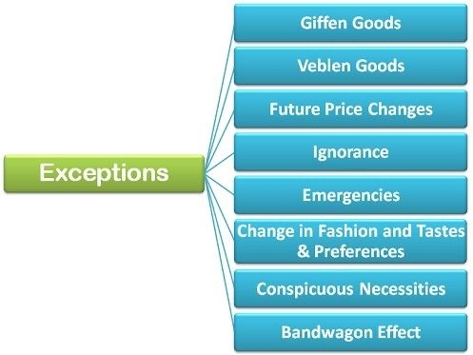
Law of demand and its exceptions

Slide 73
What is Giffen goods?
Giffen goods are low-priced products, the demand for which rises along with the price.
These products are necessary to fulfil the need for food, and they have only a few substitutes. Bread, wheat, and rice are examples of Giffen goods. The thought of Giffen goods undermines the fundamental law of demand.
What is Veblen goods?
A Veblen good is a luxury item that sees an increase in demand when the price rises. A luxury watch is an example of a Veblen good due to its high price and status of them.
Expensive Swiss watches, designer handbags, certain wines, jewellery, and luxury cars are examples of Veblen goods. They are in high demand due to their high cost.

Slide 74
Expectation of Price Change in Future:
If the consumer expects the price of the commodity to further fall in the future, then he will likely postpone his purchase despite less price of the commodity in order to avail the benefits of much lower prices in the future.
Ignorance:
Often people are misconceived as high-priced commodities are better than the low-priced commodities and rest their purchase decision on such a notion. They buy those commodities whose price are relatively higher than the substitutes.
Emergencies:
During emergencies such as war, natural calamity- flood, drought, earthquake, etc., the law of demand becomes ineffective. In such situations, people often fear the shortage of the essentials and hence demand more goods and services even at higher prices.

Slide 75
Change in fashion and Tastes & Preferences:
The change in fashion trend and tastes and preferences of the consumers negates the effect of law of demand. The consumer tends to buy those commodities which are very much 'in' in the market even at higher prices.
Conspicuous Necessities:
There are certain commodities which have become essentials of the modern
life. These are the goods which consumer buys irrespective of an increase in the price. For example TV. refrigerator, automobiles, washing machines, air conditioners, etc.
Bandwagon Effect:
This is the most common type of exception to the law of demand wherein the
consumer tries to purchase those commodities which are bought by his friends, relatives or neighbours. Here, the person tries to emulate the buying
behaviour and patterns of the group to which he belongs irrespective of the
price of the commodity.
For example, if the majority of group members have smart phones then the consumer will also demand for the smartphone even if the prices are high.

